Slide 1
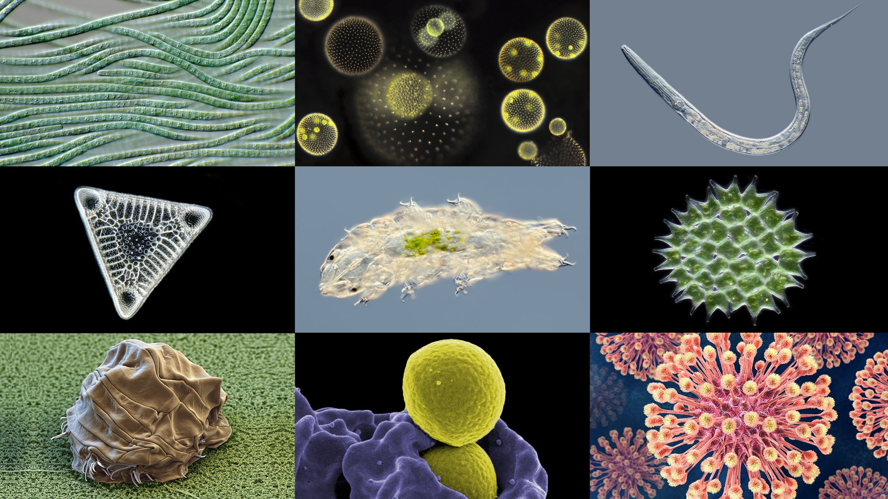
CLASS - 8
CHAPTER 02 MICROORGANISMS : FRIEND AND FOE

Slide 2
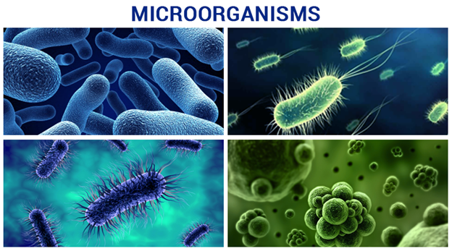
INTRODUCTION
The microorganisms or microbes are so small in size that they cannot be seen with the unaided eye. Some of these, such as the fungus that grows on bread, can be seen with a magnifying glass. Others cannot be seen without the help of a microscope. That is why these are called microbes or microorganism. Microbes are classified into four major groups. These groups are bacteria, fungi, protozoa and some algae.

Slide 3
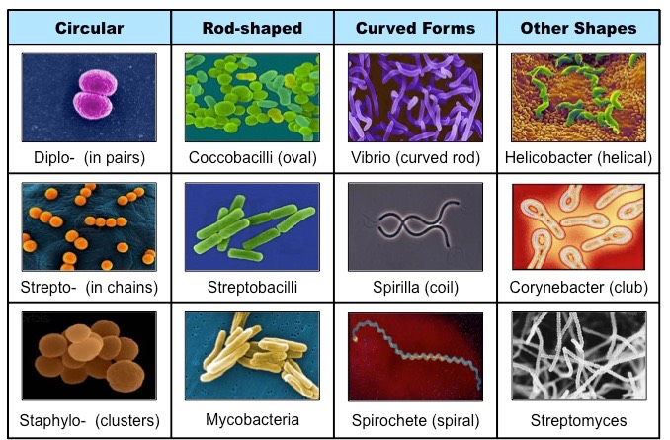
TYPES OF
BACTERIA

Slide 4
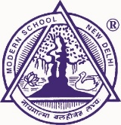
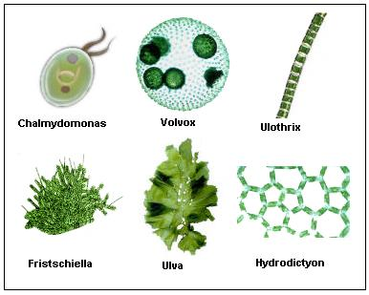
TYPES OF ALGAE

Slide 5
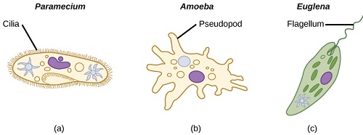
AMOEBA, PARAMECIUM & EUGLENA

Slide 6
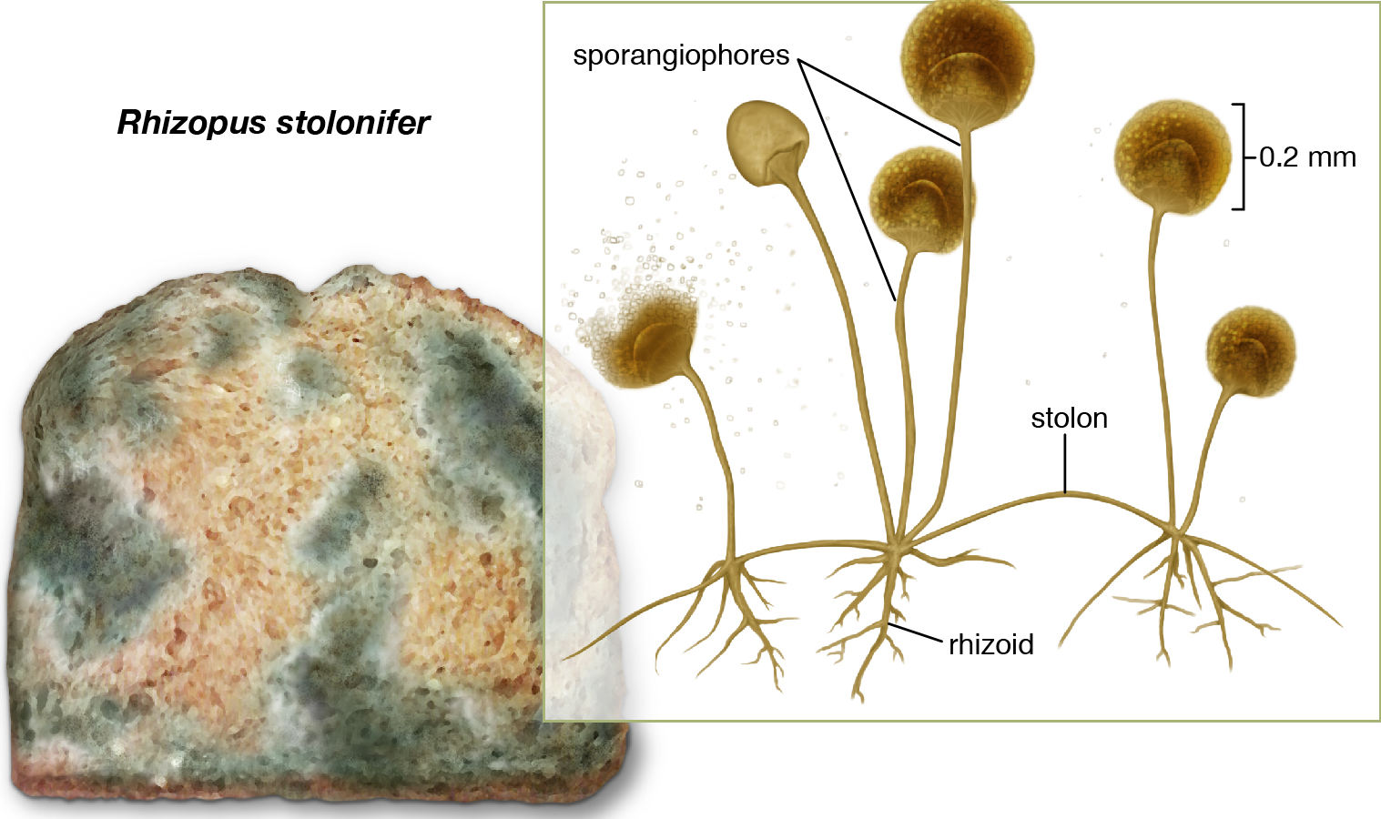
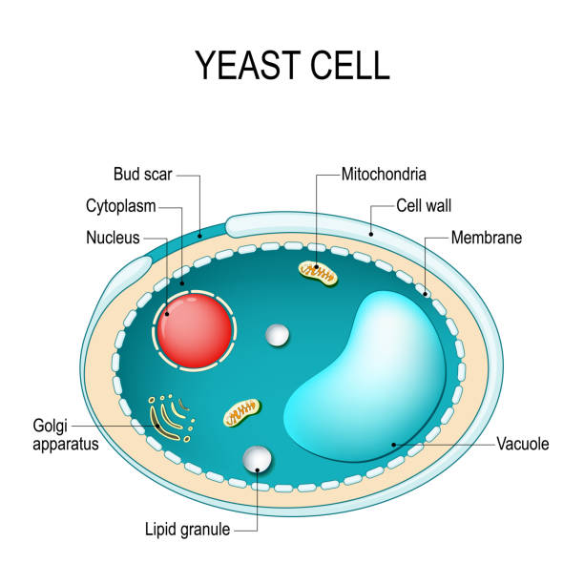
TYPES OF FUNGI

Slide 7
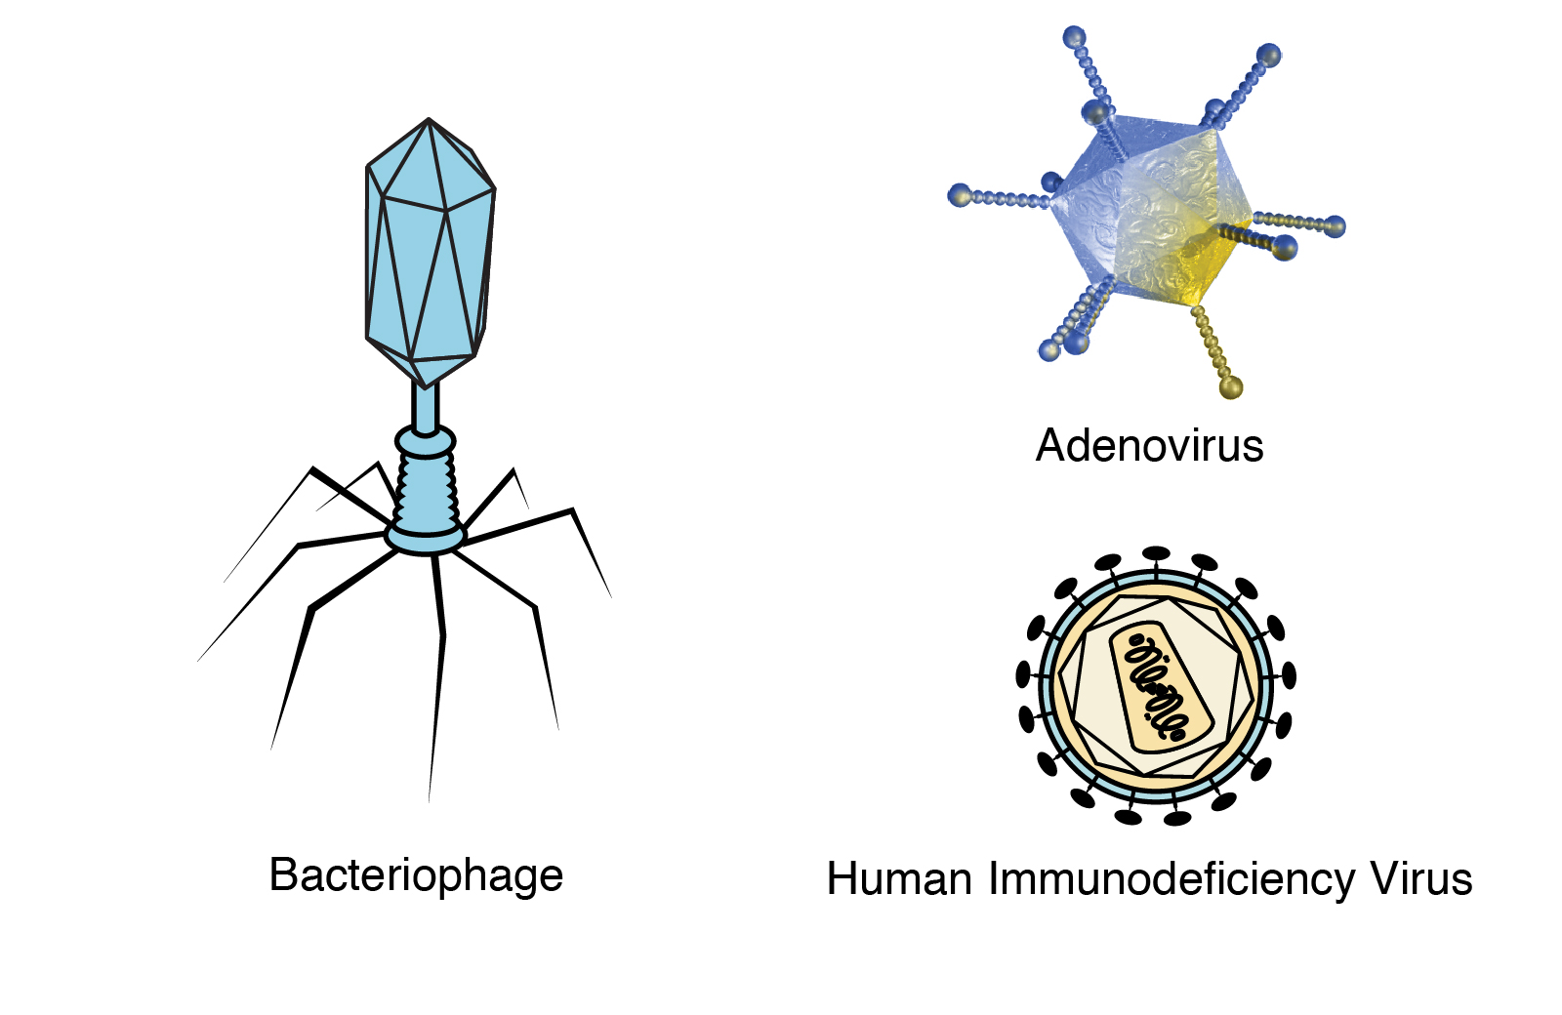
TYPES OF VIRUS

Slide 8
WHERE DO MICROORGANISMS LIVE?
Microorganisms may be single-celled like bacteria, some algae and protozoa, or multicellular, such as algae and fungi.
They can survive under all types of environment, ranging from ice cold climate to hot springs and deserts to marshy lands.
They are also found inside the bodies of animals including humans. Some microorganisms grow on other organisms while others exist freely. Microorganisms like amoeba can live alone, while fungi and bacteria may live in colonies.

Slide 9
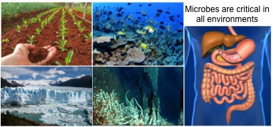
WHERE DO MICROORGANISMS LIVE?

Slide 10
FRIENDLY MICROORGANISMS
Friendly microorganisms, like probiotics, contribute to human and environmental health. They enhance digestion, support immunity, and maintain ecological balance. Examples include beneficial bacteria and fungi with positive impacts.

Slide 11
FRIENDLY MICROORGANISMS
Making of Curd and Bread
Commercial Use of Microorganism
Medicinal Use of Microorganism
Vaccine
Cleaning Environment

Slide 12
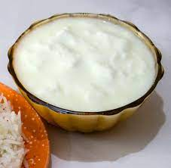
Making of Curd and Bread
Making Curd:
Fermentation by Bacteria:
  Beneficial bacteria, such as Lactobacillus, play a crucial role in curd formation.
  These bacteria ferment lactose in milk, producing lactic acid, which causes the milk proteins to coagulate and form curd.

Slide 13
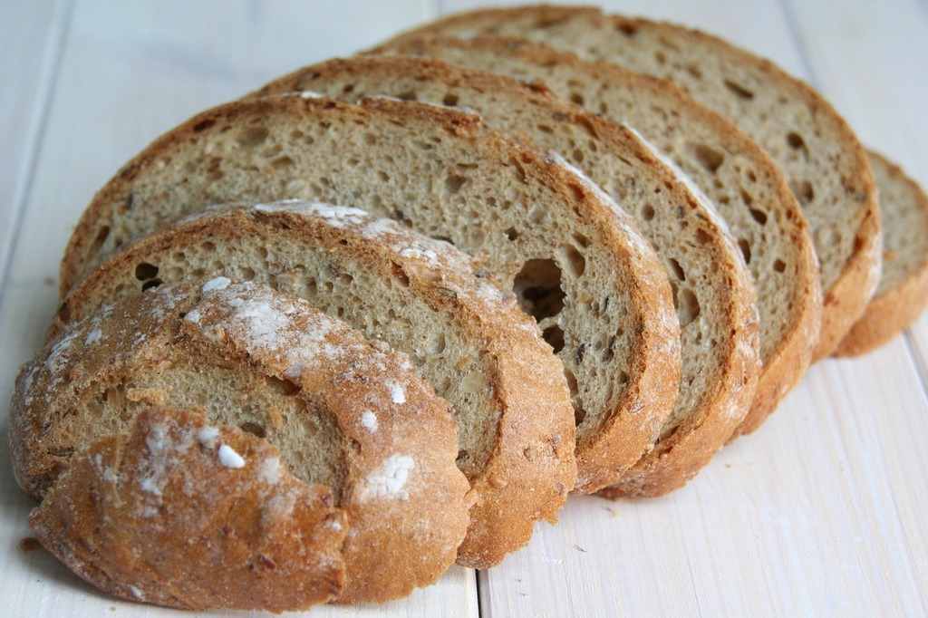
Making of Curd and Bread (cont.)
Making Bread:
Yeast Fermentation:
  Yeast is a microorganism that ferments sugars in the dough, producing carbon dioxide gas.
  The carbon dioxide causes the dough to rise, creating a light and airy texture in the bread.

Slide 14
Commercial Use of Microorganism
Alcohol Production:
Microbial Involvement: Microorganisms, particularly yeast, are crucial for the large-scale production of alcohol.
Yeast Fermentation: Yeast is cultivated on natural sugars found in grains such as barley, wheat, rice, as well as in crushed fruit juices.
Fermentation Process: The natural sugars serve as a substrate for yeast fermentation, producing alcohol as a byproduct. This process is widely used in the production of alcoholic beverages.
Wine Production:
Commercial Role of Yeast: Yeast plays a central role in the commercial production of wine.
Fermentation in Grapes: During winemaking, yeast ferments the sugars naturally present in grapes, converting them into alcohol and contributing to the unique flavors and characteristics of the wine.

Slide 15
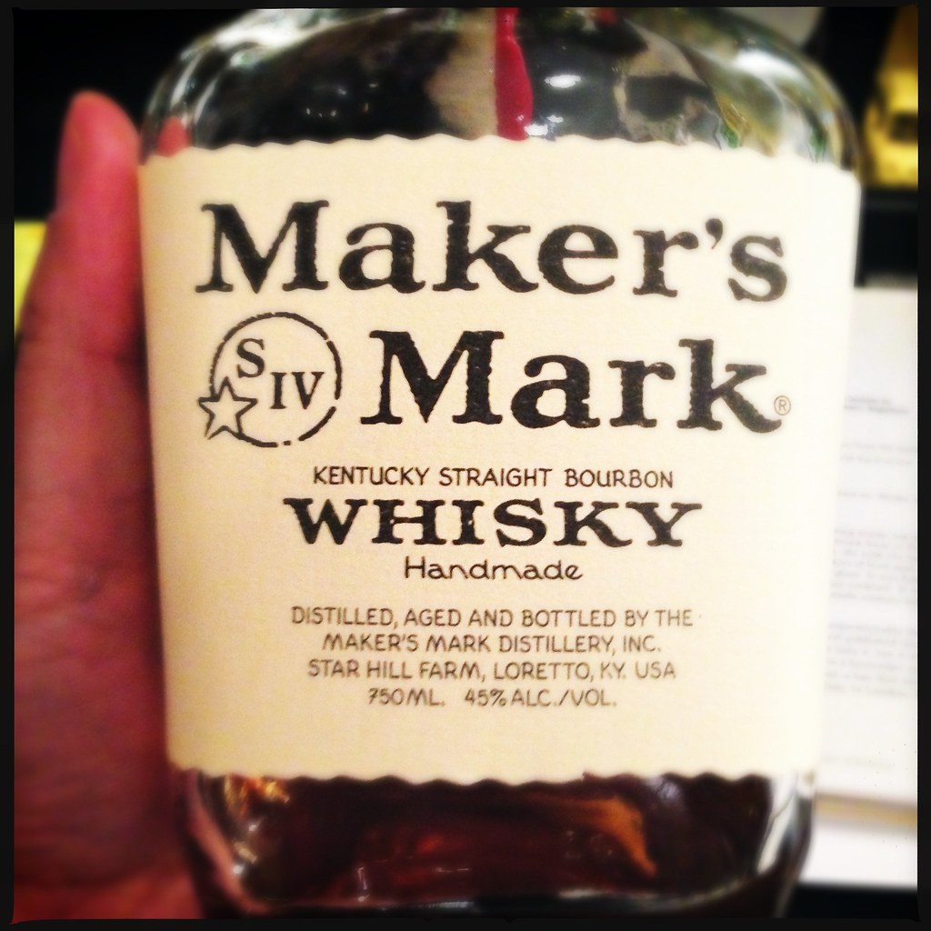
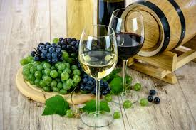

Slide 16
Commercial Use of Microorganism (cont.)
Acetic Acid (Vinegar) Production:
Microbial Transformation: Microorganisms are also involved in the production of acetic acid, commonly known as vinegar.
Acetobacter Bacteria: Acetobacter, a type of bacteria, is often used in the fermentation process to convert ethanol (alcohol) into acetic acid, resulting in the production of vinegar.

Slide 17
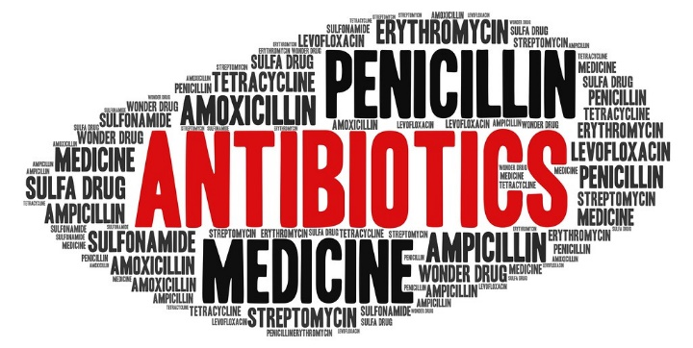
Medicinal Use of Microorganism
Antibiotic Source:
  Microorganisms are the source of antibiotics used to treat bacterial infections.
Common Antibiotics:
  Examples include penicillin, streptomycin, tetracycline, and erythromycin, derived from bacteria and fungi.
Production Process:
  Antibiotics are manufactured by cultivating specific microorganisms in controlled environments.
Diverse Applications:
  Antibiotics are used in human medicine, added to livestock feed to prevent infections, and employed in agriculture to control plant diseases.

Slide 18
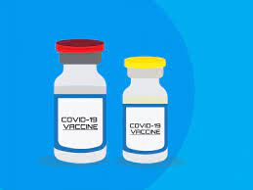
Vaccine
Antibody Response:
  Body produces antibodies to fight and remember how to combat disease-causing microbes.
Vaccine Function:
  Vaccines introduce weakened microbes, prompting antibody production for long-term protection.
Preventable Diseases:
  Diseases like cholera, tuberculosis, smallpox, and hepatitis can be prevented through vaccination.

Slide 19
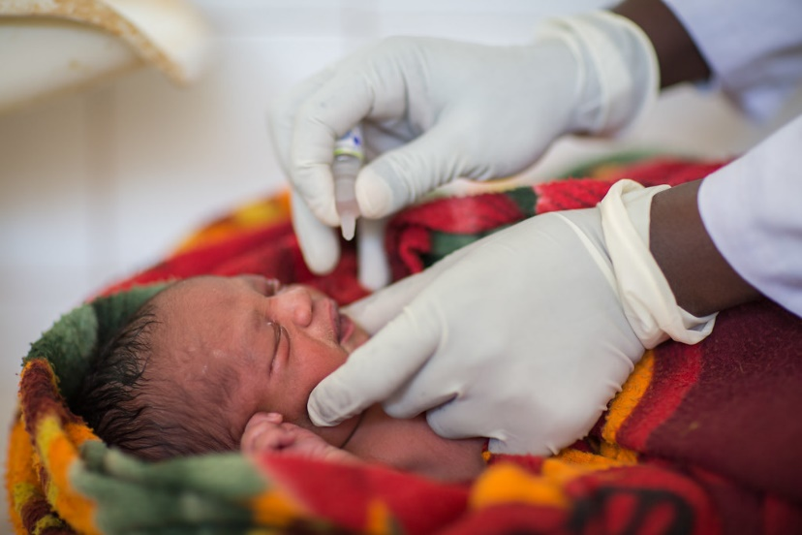
Vaccine (cont.)
Childhood Vaccinations:
  Common childhood vaccinations include polio, smallpox, and others for lasting protection.
Global Eradication Efforts:
  Global campaigns, like against smallpox, have eradicated diseases from most parts of the world.
Large-Scale Vaccine Production:
  Vaccines are made on a large scale from microorganisms to protect against various diseases.

Slide 20
Cleaning Environment
Manure Production:
  Collection of plant, vegetable, and fruit waste in a pit.
  Microbial action over time transforms waste into nutrient-rich manure.
Microbial Decomposition:
  Microbes break down plant waste, converting it into plant-usable nutrients.
Difference in Pot Contents:
  Plant waste decomposes, forming manure, while non-organic items remain unchanged without microbial action.
Microorganisms in the Environment:
  Microbes play a key role in decomposing organic matter.
  Decomposition recycles nutrients, benefiting plants and animals.
  Microbes contribute to environmental cleanup by degrading harmful substances.

Slide 21
Harmful Microorganisms
Harmful microorganisms, known as pathogens, cause diseases in humans, plants, and animals. Examples include bacteria causing anthrax and viruses leading to foot and mouth disease, posing threats to various species.

Slide 22
Microorganisms as Pathogens:
  Certain microorganisms, termed pathogens, cause diseases in humans, plants, and animals.
  Understanding their harmful impact is crucial for disease prevention and management.
Spoilage of Resources:
  Microorganisms play a role in the spoilage of food, clothing, and leather.
  Exploring their harmful activities provides insights into preserving and protecting these resources.

Slide 23
Disease causing Microorganisms in Humans
Disease causing Microorganisms in Animals
Disease causing Microorganisms in Plants

Slide 24
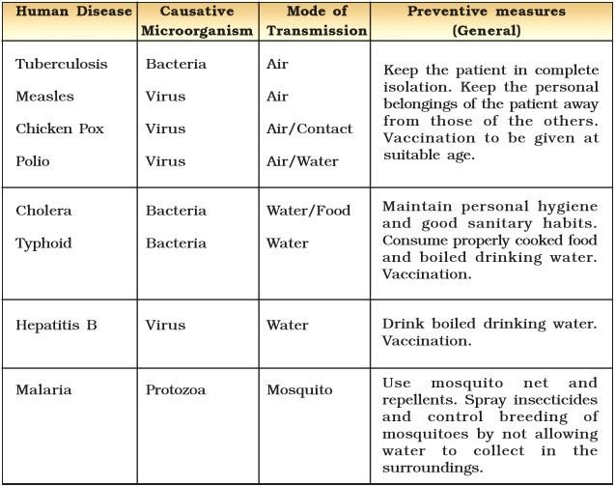
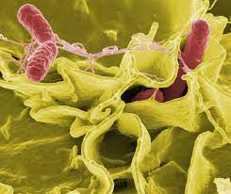
Disease causing Microorganisms in Humans

Slide 25
Disease causing Microorganisms in Humans

Slide 26
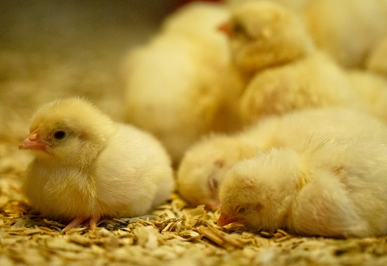
Disease causing Microorganisms in Animals
Microorganisms and Diseases:
  Microorganisms are responsible for diseases in humans, plants, and animals, posing threats to various species.
  Understanding specific examples sheds light on the impact of microbial infections.
Zoonotic Diseases:
  Anthrax, caused by a bacterium, is a dangerous disease affecting both humans and cattle.
  Foot and mouth disease in cattle is caused by a virus, showcasing the diverse range of diseases that can affect animals.

Slide 27
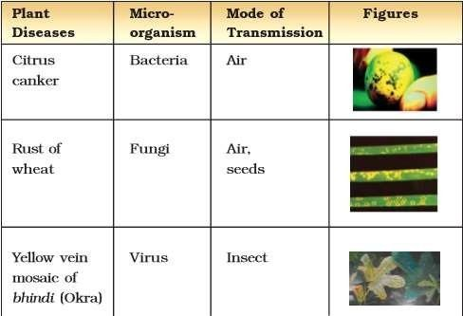
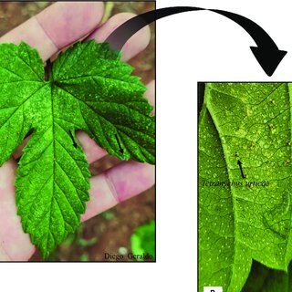
Disease causing Microorganisms in Plants

Slide 28
Food Poisoning
Food Poisoning and Microorganisms:
  Food poisoning can occur after consuming food spoiled by microorganisms.
Toxic Substance Production:
  Microorganisms growing on food may produce toxic substances.
  These substances can make the food poisonous, causing serious illness or death.
Importance of Food Preservation:
  Preservation of food is crucial to prevent spoilage by microorganisms.
  Proper preservation ensures the safety and quality of consumed food.

Slide 29
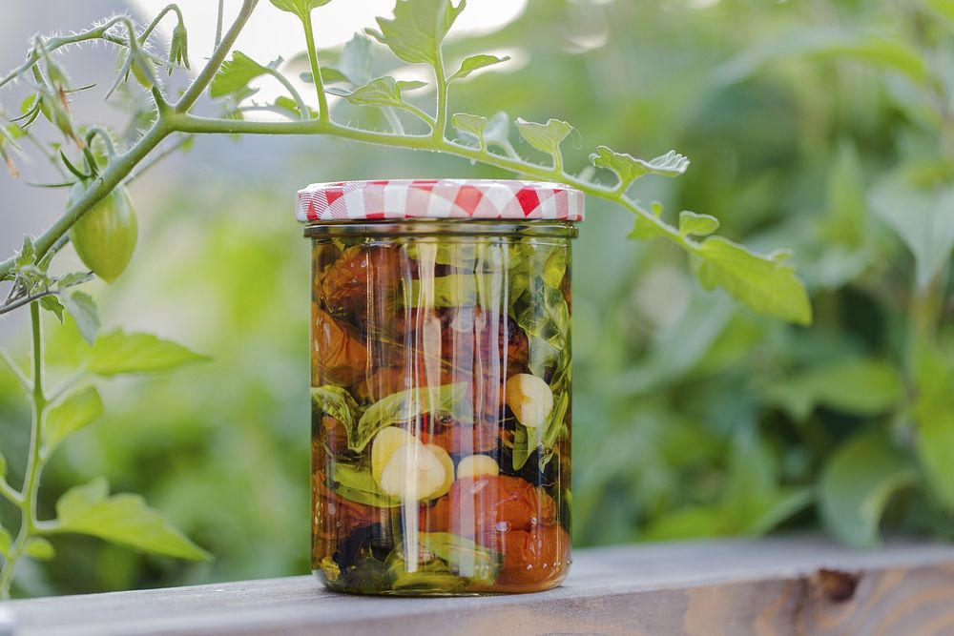
Food Preservation
Food preservation is essential for preventing spoilage by microorganisms, ensuring the safety and quality of consumed food. Various methods, from refrigeration to canning, help extend the shelf life of perishable items.

Slide 30
Food Preservation
Chemical Method
Preservation by Oil and Vinegar
Preservation by Sugar
Preservation by Common Salt
Heat and Cold Treatments
Storage and Packing

Slide 31
Preservation Method | Description
Chemical Method | Use of chemical preservatives to inhibit microbial growth and extend the shelf life of food.
Preservation by Common Salt | Immersing food in a salt solution to dehydrate and inhibit bacterial and fungal growth.
Storage and Packing | Vacuum sealing or airtight packaging to prevent the entry of microorganisms and maintain freshness.
Preservation by Sugar | High sugar concentrations in jams, jellies, and syrups to inhibit microbial growth and preserve fruits.
Preservation by Oil and Vinegar | Submerging food in oil or vinegar to create an oxygen-free environment, preventing spoilage.
Heat and Cold Treatments | Heat (canning) or freezing to kill or slow down microbial activity, preserving the food's quality.

Slide 32
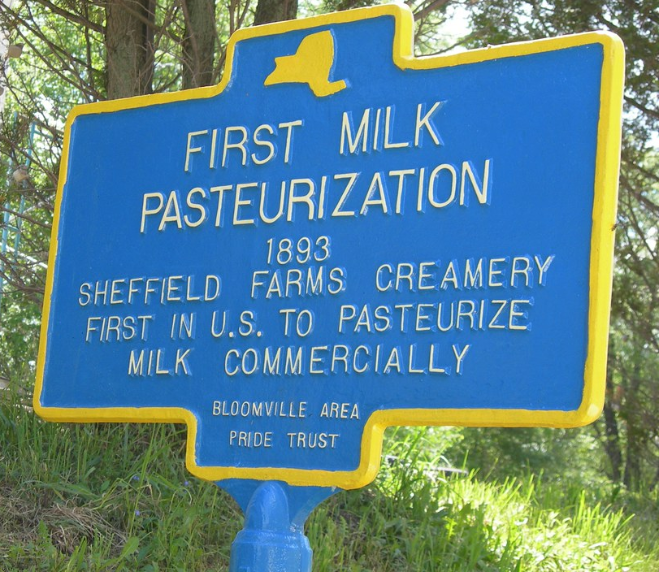
PASTEURIZATION

Slide 33
PASTEURIZATION
Definition: Pasteurization is a heat treatment process designed to kill or deactivate harmful microorganisms in food and beverages, primarily liquids like milk and wine.
Invention: Louis Pasteur developed pasteurization in the 1860s as a method to prevent the spoilage of beverages and the transmission of diseases through contaminated liquids.
Process: The process involves heating a liquid to a specific temperature for a defined period and then rapidly cooling it. This method destroys harmful bacteria, molds, and yeasts, extending the shelf life of the product.
Significance: Pasteurization revolutionized food safety and public health by reducing the risk of infectious diseases transmitted through consumables. It has become a standard method for preserving the quality and safety of various beverages.

Slide 34
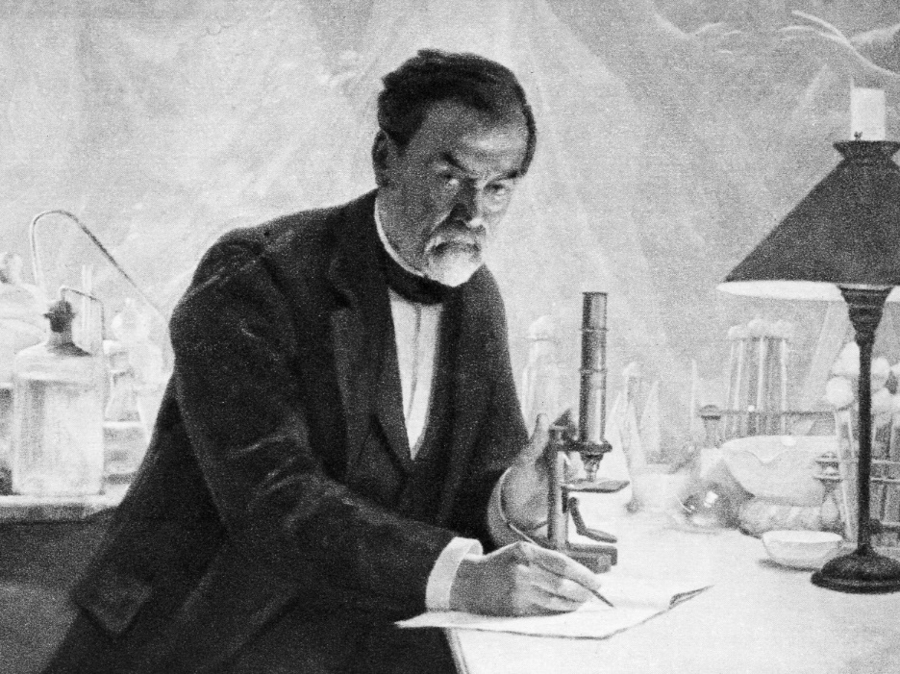
Louis Pasteur
Louis Pasteur (1822–1895) was a French chemist and microbiologist renowned for his groundbreaking contributions to the fields of microbiology and medicine. One of his significant achievements is associated with the process known as pasteurization.

Slide 35
Nitrogen Fixation
Nitrogen fixation is a vital biological process where certain microorganisms convert atmospheric nitrogen into a form usable by plants, enhancing soil fertility and promoting plant growth.

Slide 36
Role of microbes in Nitrogen Fixation
Rhizobium:
  Forms symbiotic relationships with legumes, residing in root nodules and converting atmospheric nitrogen into ammonia.
Azotobacter:
  Free-living nitrogen-fixing bacteria in the soil, contributing to non-symbiotic nitrogen fixation.
Clostridium:
  Some species of Clostridium are nitrogen-fixing bacteria that play a role in the process.
Frankia:
  Forms symbiotic associations with certain non-leguminous plants, aiding in nitrogen fixation.

Slide 37
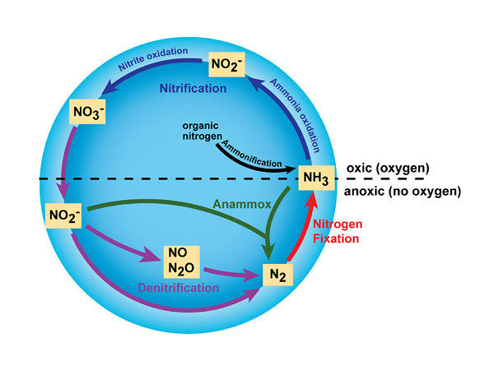
Nitrogen cycle
The nitrogen cycle is a vital natural process where nitrogen undergoes various transformations, moving between the atmosphere, soil, and living organisms, contributing to ecosystem balance and plant growth.

Slide 38
