Slide 1
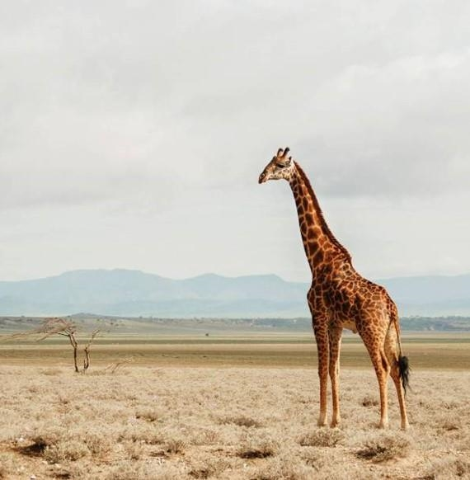
HEREDITY
CHAPTER - 9

Slide 2
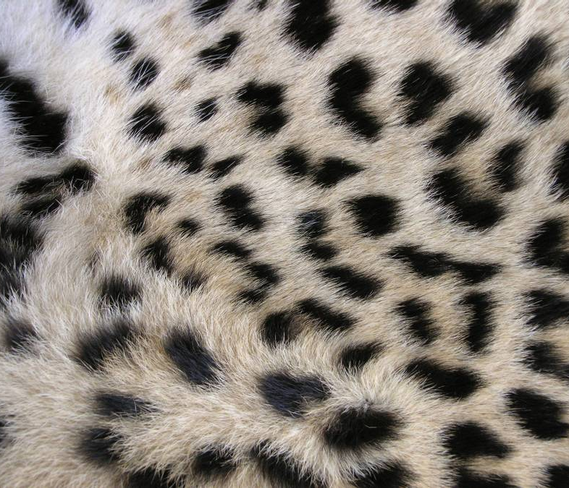
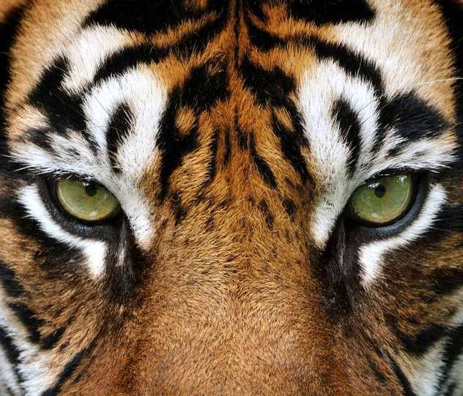
Agenda
HEREDITY
ACCUMULATION OF VARIATION DURING REPRODUCTION
INHERITED TRAITS
RULES FOR THE INHERITANCE OF TRAITS – MENDEL’S CONTRIBUTIONS
HOW DO THESE TRAITS GET EXPRESSED?

Slide 3
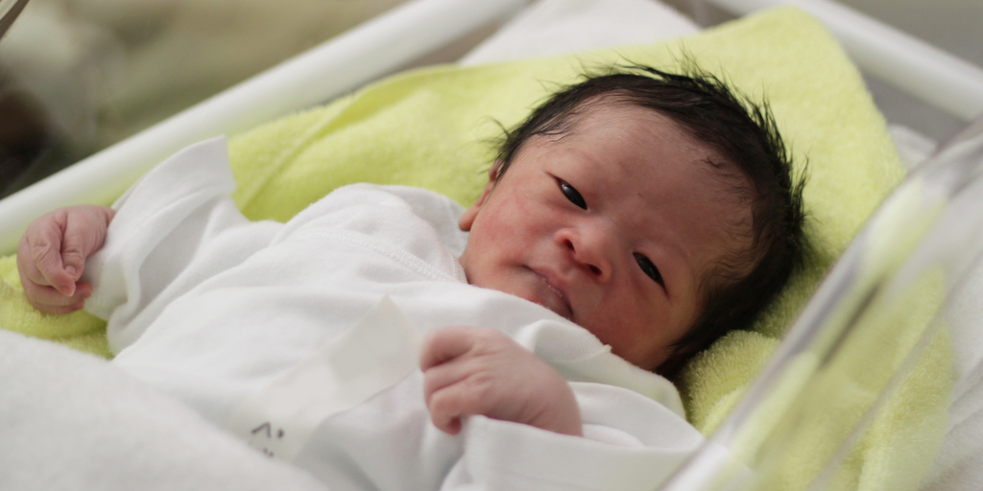
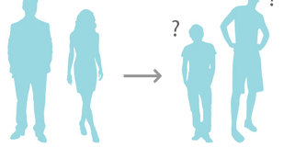
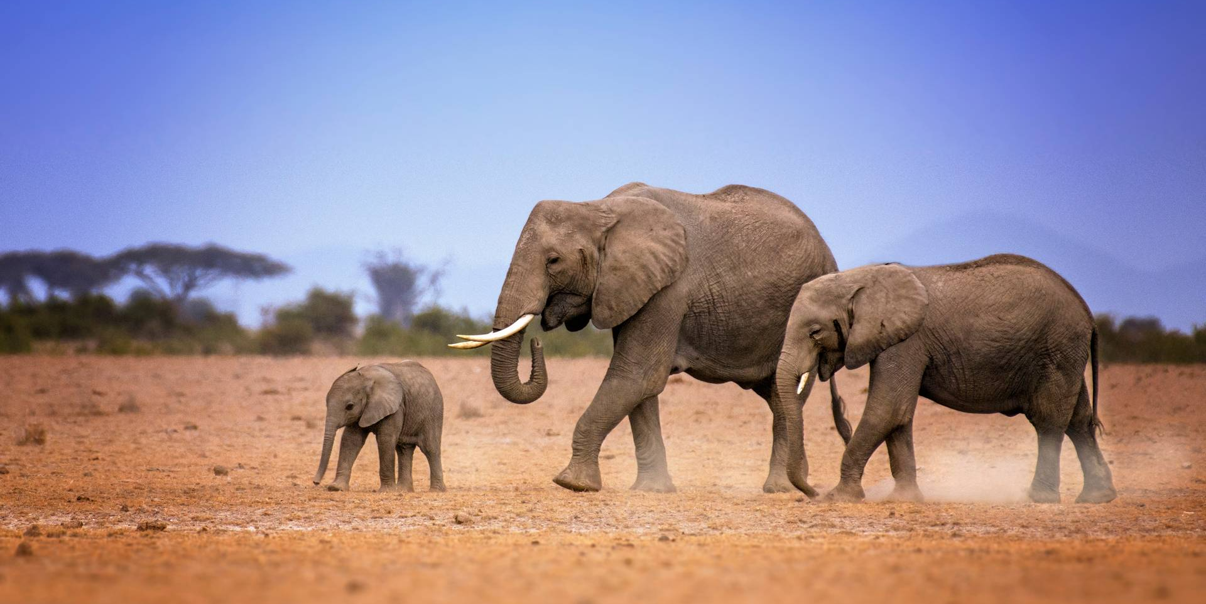
HEREDITY

Slide 4
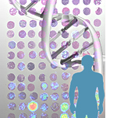
HEREDITY
Heredity, the sum of all biological processes by which particular characteristics are transmitted from parents to their offspring. The set of genes that an offspring inherits from both parents, a combination of the genetic material of each, is called the organism’s genotype. The genotype is contrasted to the phenotype, which is the organism’s outward appearance and the developmental outcome of its genes. The phenotype includes an organism’s bodily structures, physiological processes, and behaviors.

Slide 5
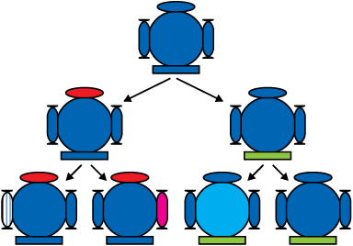
ACCUMULATION OF VARIATION DURING REPRODUCTION
The previous generation provides both a common basic body design, and subtle changes in it, for the next generation.
The second generation will have differences that they inherit from the first generation, as well as newly created differences.
Very minor differences generated due to small inaccuracies in DNA copying.
In sexual reproduction, greater diversity will be generated.

Slide 6
ACCUMULATION OF VARIATION DURING REPRODUCTION
Do all these variations in a species have equal chances of surviving in the environment in which they find themselves?
NO
Depending on the nature of variations, different individuals would have different kinds of advantages.

Slide 7
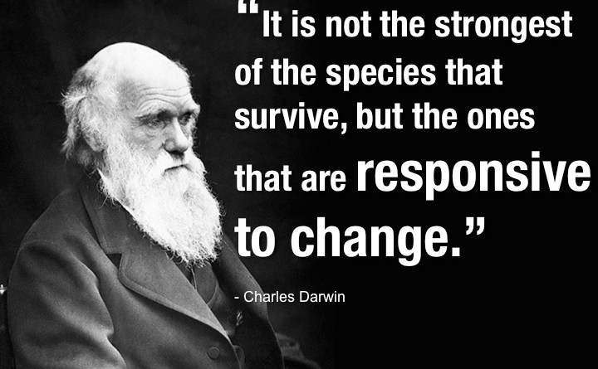
Selection of variants by environmental factors forms the basis for evolutionary processes,

Slide 8
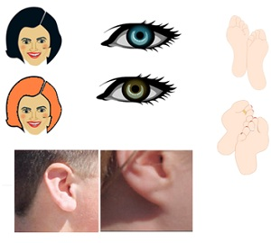
Inherited Traits
Those traits which an offspring received from their parents are called inherited traits.
Tongue rolling
Earlobe attachment
Dimples
Curly hair
Freckles
Handedness
Hairline shape
Green/Red Colour-blindness

Slide 9
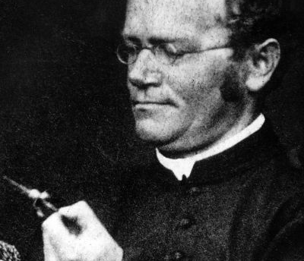
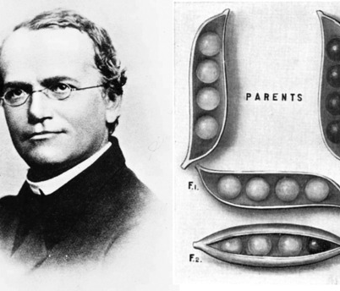
Rules For The Inheritance Of Traits – Mendel’s Contributions
Gregor Mendel was an Austrian monk who discovered the basic principles of heredity through experiments in his garden. Mendel's observations became the foundation of modern genetics and the study of heredity, and he is widely considered a pioneer in the field of genetics.

Slide 10
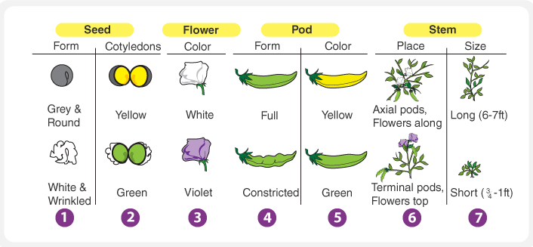
Mendel’s Contributions
Mendel experimented using many physical characters of garden peas.
Gregor Mendel formulated rules for inheritance after thorough understanding and experimentation.

Slide 11
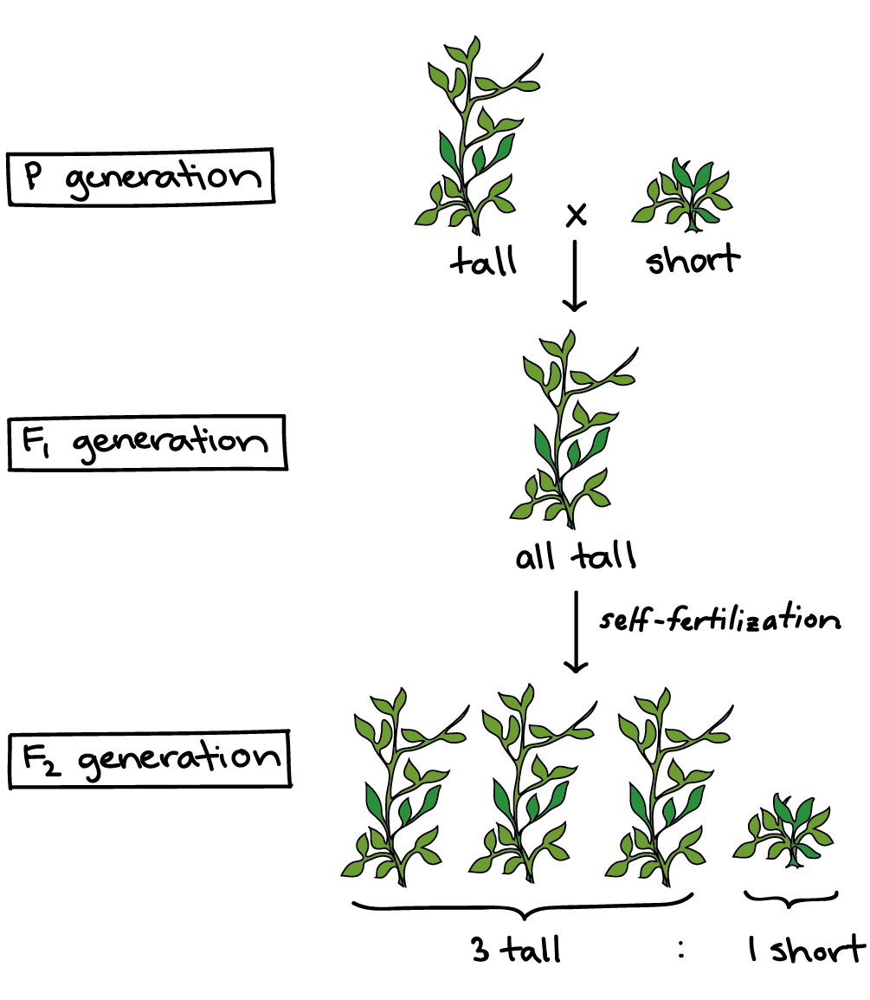
Mendel’s Contributions
He took pea plants with different characteristics – a tall plant and a short plant, produced progeny from them, and calculated the percentages of tall or short progeny.

Slide 12
Following are his observations:
He noticed that there were no midway traits in F1 progeny, no plants with medium height
All plants produced were tall
Only one parental trait was observed and not a mixture of two.
Checked if tall plants in F1 progeny and parent plant are same
Tested this by getting both the parental plants and F1 tall plants to reproduce through self-pollination.
Observed, F2 progeny(second-generation) obtained by the above cross, are all not tall, a quarter of them was short.
Deduced both tallness and shortness traits are inherited but only tallness was expressed
Hence Mendel proposed that genes controlling traits are present in organisms who reproduce sexually.
This reproduction depends on the parents, it can either be different or identical.

Slide 13
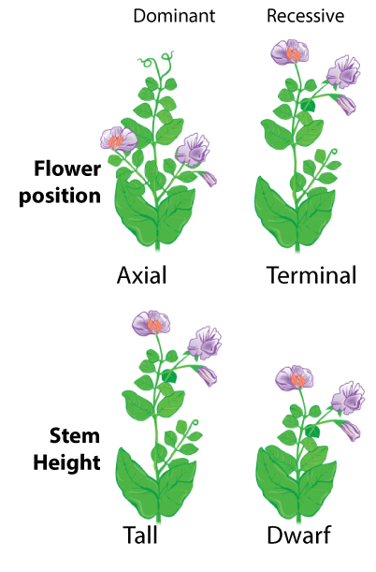
What happens when pea plants showing two different characteristics, rather than just one, are bred with each other?

