Slide 1
CLASS – 10
SUBJECT – SCIENCE (BIOLOGY)
CHAPTER – 8 HOW DO ORGANISM REPRODUCE
CONCEPT – ASEXUAL REPRODUCTION
PPT – 1

Slide 2
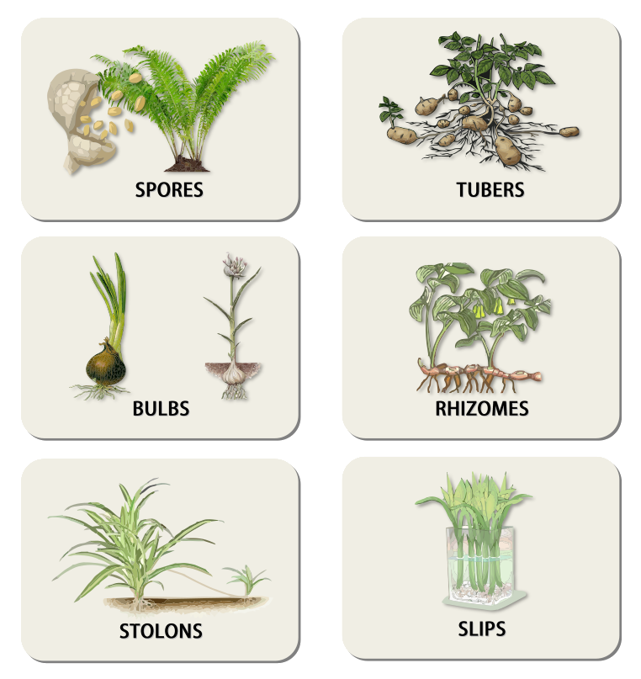
HOW DO ORGANISM REPRODUCE
CLASS X
BIOLOGY

Slide 3
Asexual reproduction
Asexual reproduction is a method of reproduction that involves only one organism. A single organism reproduces two or multiple organisms on its own. This is seen in all unicellular organisms, some multicellular organisms and a few plants.
PAGE NO 1

Slide 4

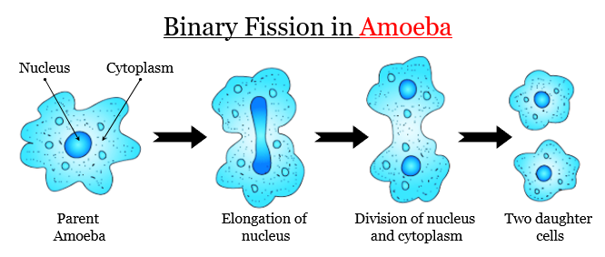
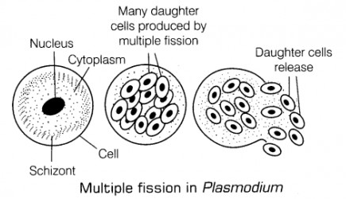
Fission
Fission is an asexual reproduction that is common in most of the unicellular organisms.
When the fission results in two daughter cells, it is binary fission (e.g. paramecium).
When fission results in many daughter cells, it is called multiple fission (e.g. Plasmodium).
Planes of fission may be different for different organisms.
PAGE NO 3
PAGE NO 2
PAGE NO 1

Slide 5
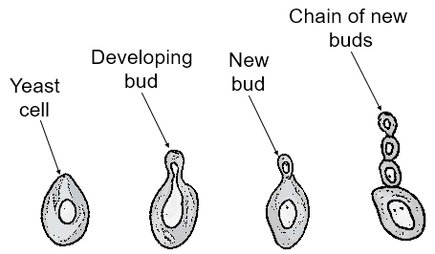
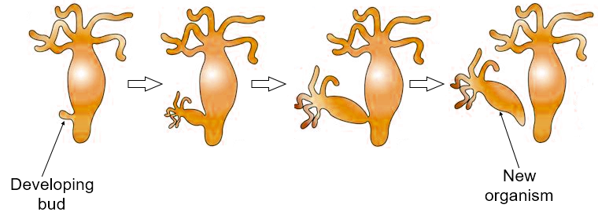
Budding
Budding is a type of asexual reproduction in which a small cyst-like structure is formed on the parent’s body, which gives rise to a new individual.
Bud may remain attached to the parent (yeast) or may separate and become a new individual (hydra).
PAGE NO 5
PAGE NO 4
PAGE NO 1

Slide 6
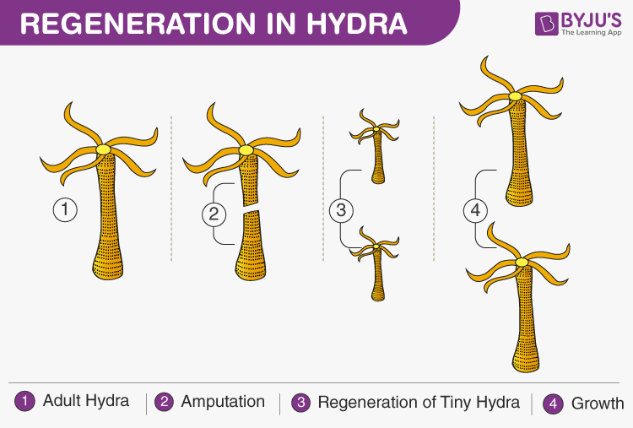
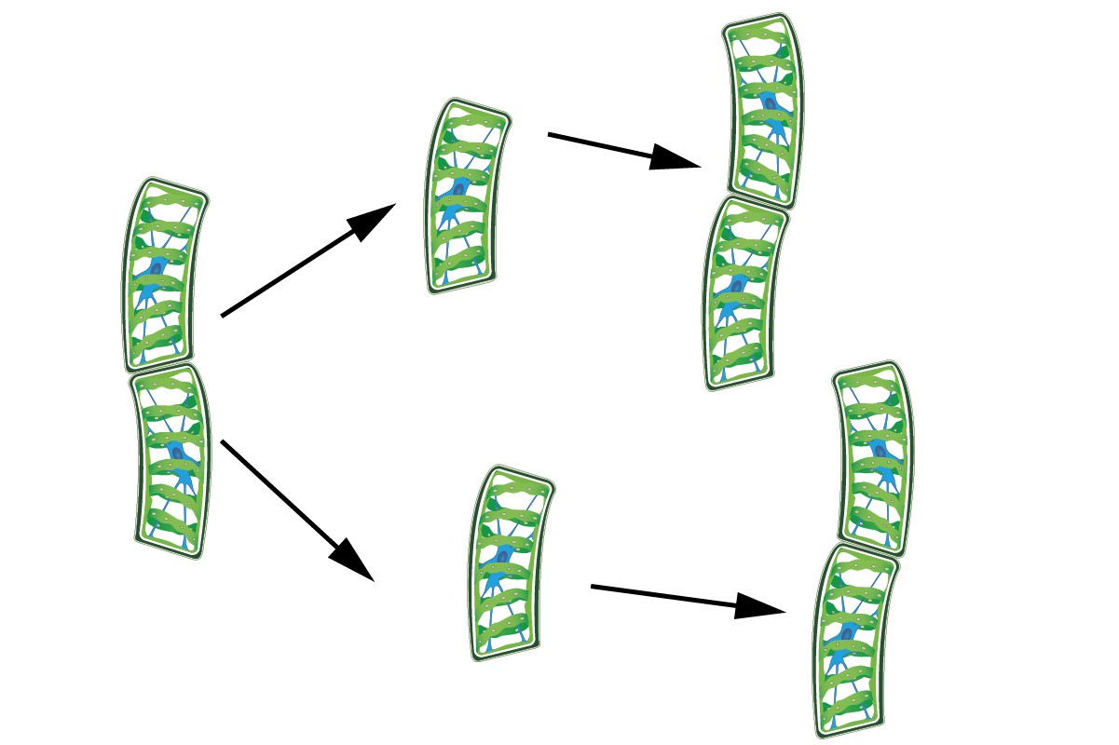
Regeneration and fragmentation
Regeneration is the process of growing back the lost organ or body part by the organism (e.g. lizard).
Fragmentation is the process by which an organism gets fragmented into smaller pieces and each piece grows into a whole new organism.
E.g. Planaria, Hydra
PAGE NO 7
PAGE NO 6
PAGE NO 1

Slide 7
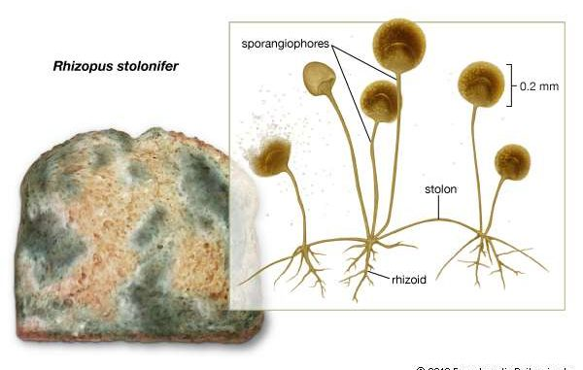

Spore formation
Vegetative propagation
Organisms such as fungi make spores that can grow into complete new individuals when dispersed from their fruiting body.
This is a type of asexual reproduction seen in plants.
The vegetative part of the plant, like leaves, stem, roots, gives rise to a new plant.
Vegetative propagation can be artificial or natural.
Natural vegetative propagation happens through leaves (e.g. bryophyllum), stem (e.g. turmeric, ginger), runners/stolon (e.g.grass runners, strawberry), bulbs ( e.g. onion, lily), etc.
PAGE NO 9
PAGE NO 8
PAGE NO 1

Slide 8
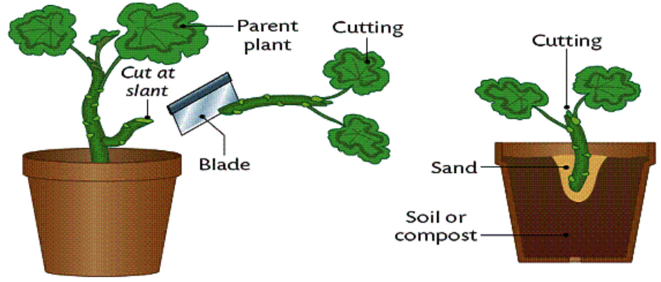
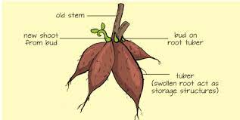

Artificial methods include cutting, grafting, layering and plant tissue culture.
The plants propagated vegetatively are given below:
Stem
Runners grow horizontally above the ground. The buds are formed at the nodes of the runners.
Roots
New plants emerge out of swollen, modified roots known as tubers. Buds are formed at the base of the stem.
PAGE NO 11
PAGE NO 10
PAGE NO 1

Slide 9
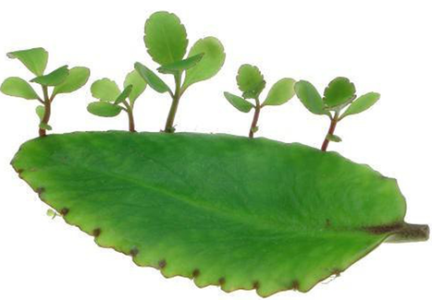
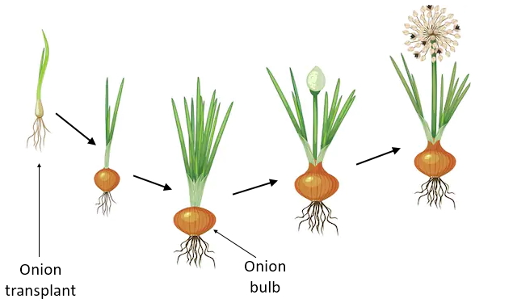

Leaves
Leaves of a few plants get detached from the parent plant and develop into a new plant.
Bulbs
Bulbs have an underground stem to which the leaves are attached. These leaves are capable of storing food. The centre of the bulb contains an apical bud that produces leaves and flowers. Shoots are developed from the lateral buds.
PAGE NO 13
PAGE NO 12
PAGE NO 1

Slide 10
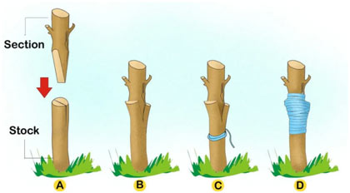
Grafting
In this, the cutting from some other plant is attached to the stem of plant rooted in the ground. The tissues of the graft become integrated with the tissues of the rooted plant and develop as a single plant over time.
Artificial Vegetative Propagation
The most common types of vegetative reproduction occurring artificially include:
Cutting
In this, a part of a plant, specifically a stem or leaf is cut and planted in the soil. These cuttings are sometimes treated with hormones to induce root development. The new plant is formed from the adventitious roots developing from the cutting.
PAGE NO 15
PAGE NO 14
PAGE NO 1

Slide 11
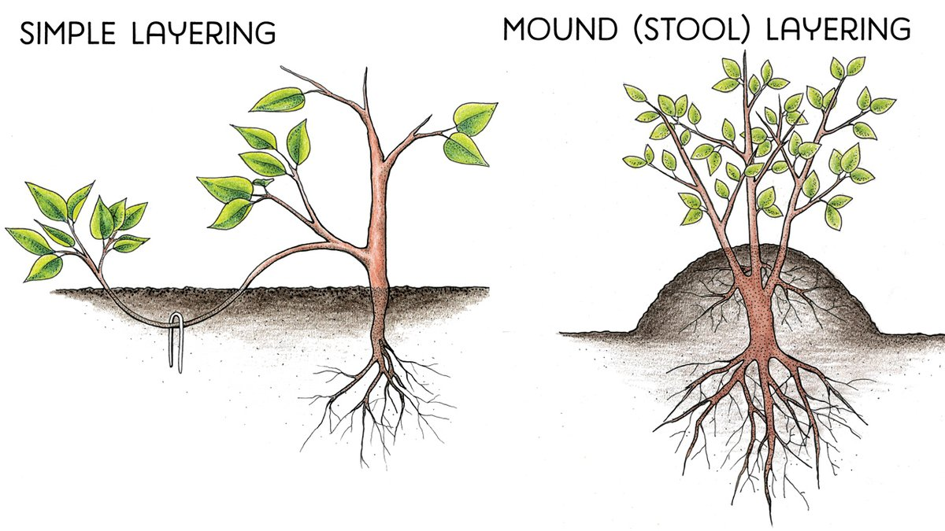
Layering
In this, the stem of the plant is bent to the ground and covered with soil. Adventitious roots emerge from the plant parts covered with the soil. This attached stem with developing roots is known as a layer.
Tissue Culture
In this, the plant cells from different parts of a plant are cultured in the laboratory to develop a new plant. This technique is helpful in increasing the number of rare and endangered plant species that are unable to grow under natural conditions.
PAGE NO 17
PAGE NO 16
PAGE NO 1

Slide 12
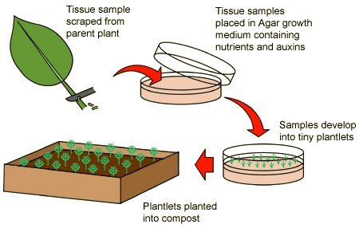
PAGE NO 18

Slide 13
