Slide 1
Reproduction in Humans
An Overview of the Human Reproductive System

Slide 2
The importance of reproduction in the continuation of the human species.
Continuation of the Species
Genetic Diversity and Evolution
Cultural and Social Significance
Emotional Fulfilment and Connection

Slide 3
Male Reproductive System

Slide 4
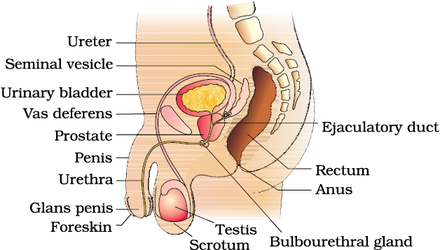

Slide 5
Anatomy:
Testes:
  Description: Paired, oval-shaped organs located in the scrotum.
  Function: Production of sperm (spermatogenesis) and secretion of testosterone.
Scrotum:
  Description: External sac that houses the testes.
  Function: Regulates the temperature of the testes, maintaining an environment conducive to sperm production.

Slide 6
Anatomy:
Seminal Vesicles:
  Description: Glandular structures located behind the bladder.
  Function: Produce a significant portion of seminal fluid, rich in fructose and prostaglandins, contributing to sperm nourishment and motility.
Prostate Gland:
  Description: Walnut-sized gland located below the bladder.
  Function: Secretes an alkaline fluid that enhances sperm motility and viability; constitutes a portion of seminal fluid.
Cowper's (Bulbourethral) Glands:
  Description: Small glands located below the prostate.
  Function: Secrete a clear, lubricating fluid that cleanses the urethra and facilitates the passage of sperm during ejaculation.

Slide 7
Anatomy:
Urethra:
  Description: Tubular structure that extends from the bladder through the penis.
  Function: Conducts both urine and semen out of the body, but not simultaneously.
Penis:
  Description: External organ that contains the urethra.
  Function: Delivers sperm into the female reproductive tract during sexual intercourse.

Slide 8
Function
Sperm Production
Hormone Secretion
Sperm Maturation and Storage
Sperm Transportation
Ejaculation

Slide 9
Female Reproductive System

Slide 10
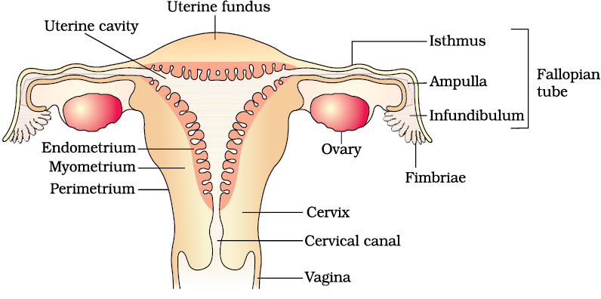

Slide 11
Anatomy
Ovaries:
  Description: Paired, almond-shaped organs located on either side of the uterus.
  Function: Production of eggs (ova) and secretion of estrogen and progesterone.

Slide 12
Anatomy
Fallopian Tubes (Oviducts):
  Description: Pair of tubes extending from the ovaries to the uterus.
  Function: Transportation of eggs from the ovaries to the uterus; site of fertilization if sperm are present.
Uterus:
  Description: Hollow, muscular organ located in the pelvic cavity.
  Function: Nurturing and supporting a developing fetus during pregnancy. The inner lining, the endometrium, thickens in preparation for potential implantation.

Slide 13
Anatomy
Vagina:
  Description: Muscular tube connecting the cervix to the external genitals.
  Function: Serves as the birth canal during childbirth and the passage for menstrual blood; also involved in sexual intercourse.
Breasts (Mammary Glands):
  Description: Glandular tissue located over the pectoral muscles.
  Function: Production of milk for breastfeeding during pregnancy and lactation.

Slide 14
Function
Ovulation and Egg Production:
  The ovaries produce eggs (ova) through a process called ovulation. This typically occurs monthly, where a mature egg is released from one of the ovaries.
Hormone Secretion:
  The ovaries secrete estrogen and progesterone, two hormones that regulate the menstrual cycle. These hormones play crucial roles in the development of secondary sexual characteristics, maintenance of the menstrual cycle, and preparation of the uterus for pregnancy.

Slide 15
Function
Menstruation:
  The uterus undergoes a monthly cycle where its lining thickens in preparation for a potential pregnancy. If fertilization does not occur, the uterine lining is shed during menstruation.
Fertilization and Pregnancy:
  The fallopian tubes transport eggs from the ovaries to the uterus. If a sperm fertilizes the egg in the fallopian tube, the fertilized egg (zygote) travels to the uterus and implants into the uterine lining, initiating pregnancy.

Slide 16
Menstrual Cycle

Slide 17
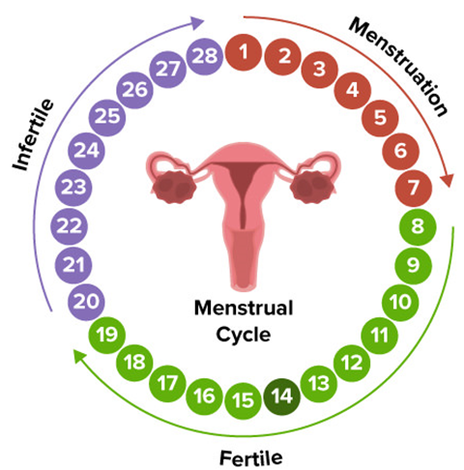

Slide 18
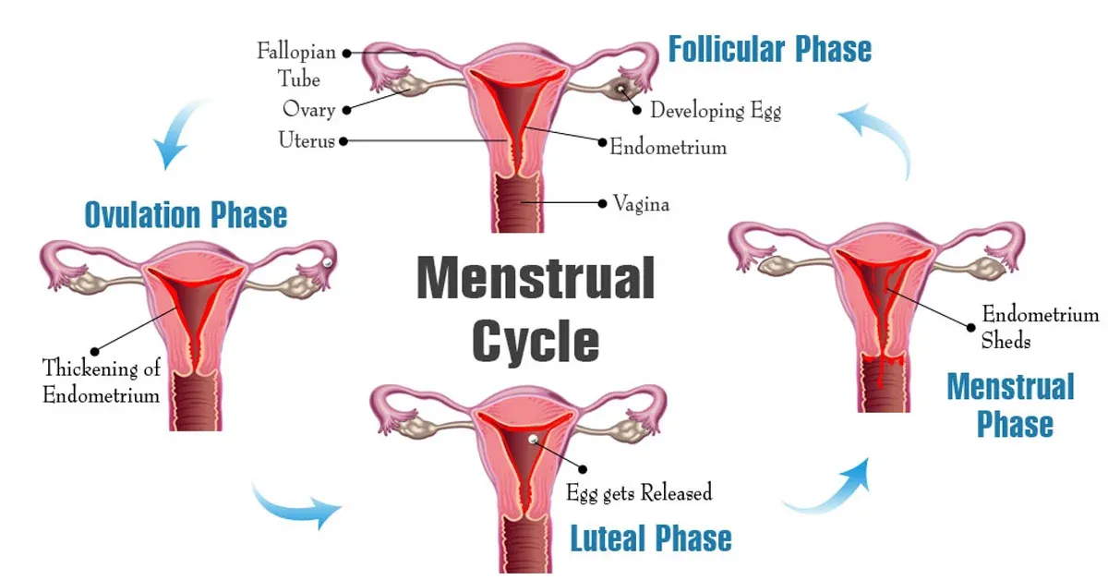

Slide 19
Menstrual Cycle
The menstrual cycle consists of several phases, each characterized by specific hormonal changes and events within the female reproductive system.
Menstrual Phase:
  Duration: Days 1-5
  Description: Menstruation occurs as the uterine lining, or endometrium, sheds. This phase marks the beginning of the menstrual cycle.
Follicular Phase:
  Duration: Days 1-13 (varies)
  Description: The pituitary gland releases follicle-stimulating hormone (FSH), stimulating the ovaries to develop several follicles. One dominant follicle matures and releases an egg.

Slide 20
Menstrual Cycle
Ovulation:
  Duration: Around Day 14 (midway in a 28-day cycle)
  Description: The mature follicle releases an egg (ovum) from the ovary into the fallopian tube. Ovulation is triggered by a surge in luteinizing hormone (LH).
Luteal Phase:
  Duration: Days 15-28 (approximately)
  Description: The empty follicle transforms into a structure called the corpus luteum, which produces progesterone. Progesterone prepares the uterine lining for potential embryo implantation. If fertilization doesn't occur, the corpus luteum breaks down, leading to a decline in hormone levels.
Menstrual Cycle Regulation:
  Control: The menstrual cycle is regulated by the interplay of hormones, including estrogen, progesterone, FSH, and LH. The hypothalamus, pituitary gland, and ovaries orchestrate this hormonal dance.

Slide 21
Fertilization

Slide 22
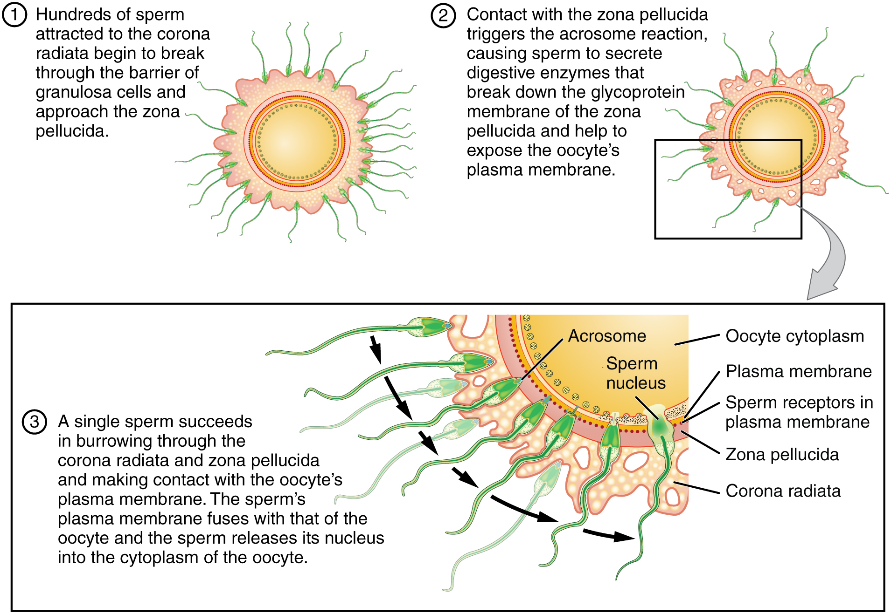

Slide 23
Pregnancy

Slide 24
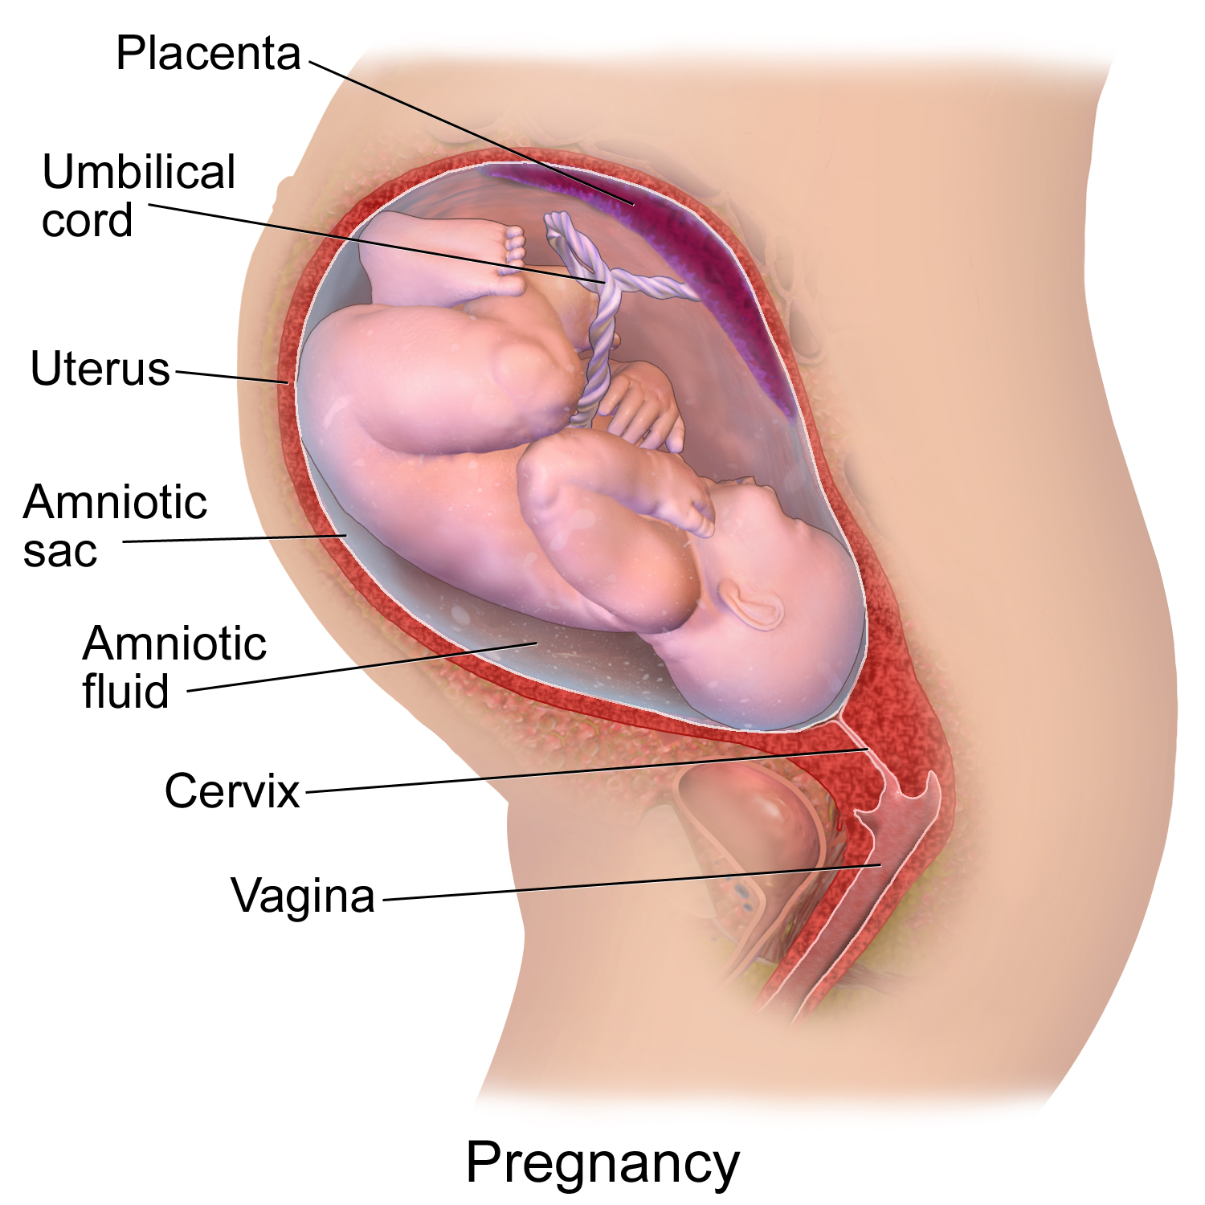

Slide 25
Stages
Conception
Implantation
Embryonic Development

Slide 26
Stages
Formation of Placenta and Umbilical Cord
Trimesters
Labor and Birth

Slide 27
Placenta
The placenta is a vital organ that develops during pregnancy and plays a crucial role in supporting the growing fetus.
Structure:
  The placenta is a disc-shaped organ with fetal blood vessels (from the umbilical cord) and maternal blood vessels. These vessels are in close proximity but do not mix.
Exchange of Nutrients and Oxygen:
  The primary function of the placenta is to facilitate the exchange of nutrients, oxygen, and waste products between the mother and the fetus. Nutrients and oxygen from the mother's blood pass through the placenta to the fetal blood, nourishing the developing fetus.

Slide 28
Placenta
Waste Removal:
  Waste products, including carbon dioxide and other metabolic byproducts, are transferred from the fetal blood to the maternal blood for elimination.
Hormone Production:
  The placenta produces hormones essential for maintaining pregnancy, such as human chorionic gonadotropin (hCG), which signals the ovaries to continue producing progesterone during the early stages of pregnancy.

Slide 29
Childbirth

Slide 30
Childbirth
Onset of Labor:
  Contractions begin, indicating the start of labor.
Three Stages of Labor:
  First Stage: Dilation of the cervix.
  Second Stage: Baby's delivery.
  Third Stage: Placenta delivery.
Methods of Childbirth:
  Vaginal birth or Cesarean section (C-Section).

Slide 31
Contraception

Slide 32
Types of Contraception
Barrier Methods
Hormonal Methods
Intrauterine Devices
Sterilization
Emergency Contraception

Slide 33
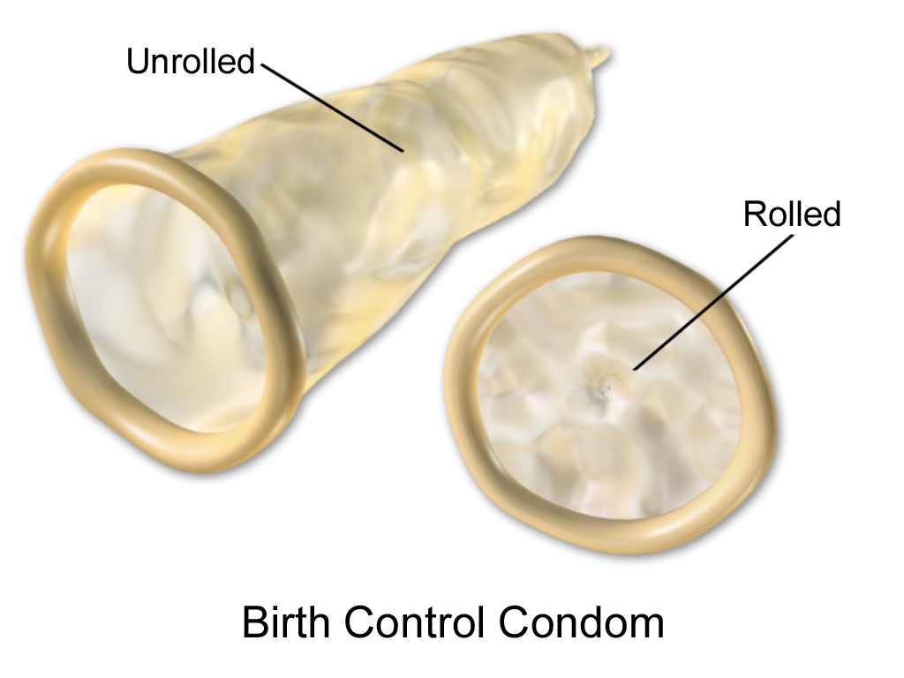
Barrier Methods
Condoms, diaphragms, cervical caps

Slide 34
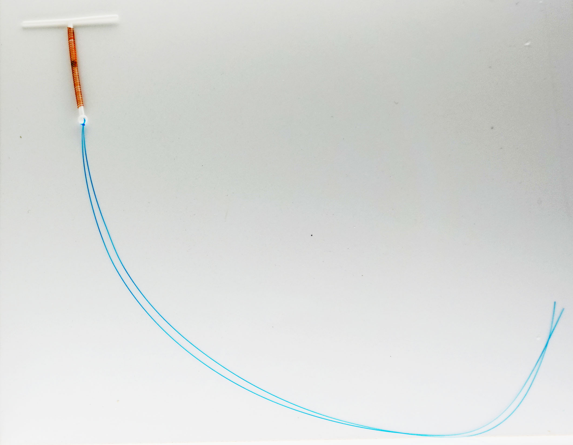
Intrauterine Devices
Small devices inserted into the uterus.

Slide 35
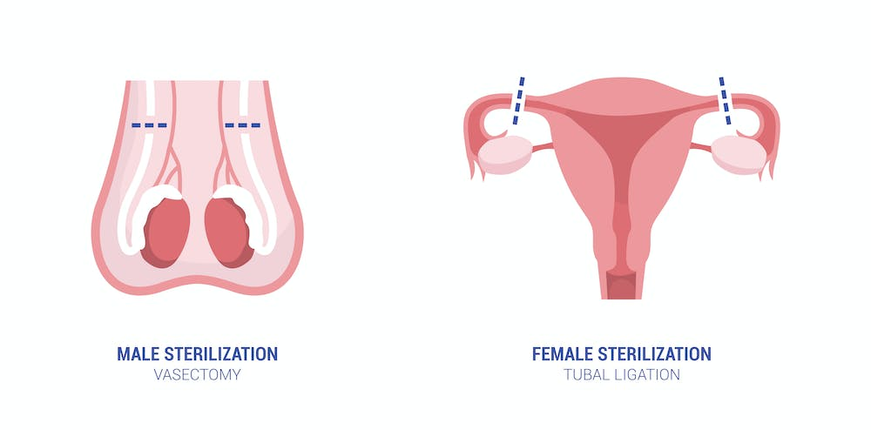
Sterilization
Permanent methods like tubal ligation or vasectomy.

Slide 36
Reproductive Health
Involves the physical, mental, and social well-being of the reproductive system.

Slide 37
Reproductive Health
Components:
  Family planning, safe sex practices, and access to reproductive healthcare.
Sexually Transmitted Diseases (STDs):
  Definition: Infections transmitted through sexual contact.
  Common STDs: HIV/AIDS, chlamydia, gonorrhea, syphilis, herpes, HPV.
  Prevention: Safe sex practices (condoms), vaccination (HPV), regular screenings.

Slide 38
Reproductive Health
Infertility:
Definition: Inability to conceive after a year of unprotected intercourse.
Causes: Physical issues, hormonal imbalances, age, lifestyle factors.
Diagnosis: Medical evaluations, tests for both partners.
Treatment: Assisted reproductive technologies (ART), medications, surgery.
Emotional Impact: Emotional support is crucial during fertility challenges.

