Slide 1
CLASS – 11
SUBJECT – BIOLOGY
CHAPTER – 18
CONCEPT – BODY FLUID & CIRCULATION
PPT- 2

Slide 2
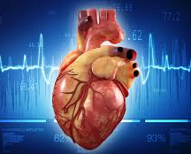
BODY FLUID AND CIRCULATION
CLASS XI
Notes:
NOTE:
To change the image on this slide, select the picture and delete it. Then click the Pictures icon in the placeholder to insert your own image.

Slide 3
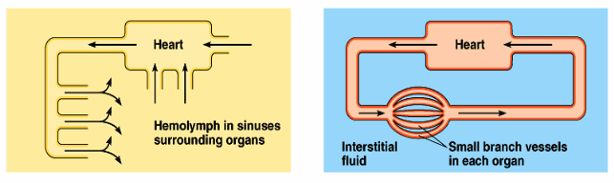
Circulatory Pathways – There are two types of circulatory systems:
Open circulatory system
Blood vessels are not found and blood is present in the open cavity known as sinuses, where internal organs float. This type of system is present in arthropods and molluscs.
Closed circulatory system
Blood vessels circulate the blood. This type of system is present in Annelids and Chordates.

Slide 4
Types of heart & circulation in vertebrates
Pisces
2 Chambered heart, 1 Atrium & 1 Ventricle.
Amphibian and Reptiles
3 chambered, 2-atrium and 1-ventricle
Crocodiles, Aves and Mammals
4 chambered, 2-atrium and 2-ventricle
Single Circulation
Incomplete Double Circulation
Double Circulation

Slide 5
Human Circulatory System
Heart – Four chambered, derived from mesoderm. It is present between the two lungs in the thoracic cavity and protected by the pericardium.
A bicuspid (mitral) valve is present between the left, atrium and ventricle
A tricuspid valve is present between the right, atrium and ventricle
The right ventricle opens into the pulmonary artery and the left ventricle opens into the aorta. Both the openings are guarded by semilunar valves
The heart is made up of cardiac muscles. There are nodal tissues also present in the heart.

Slide 6
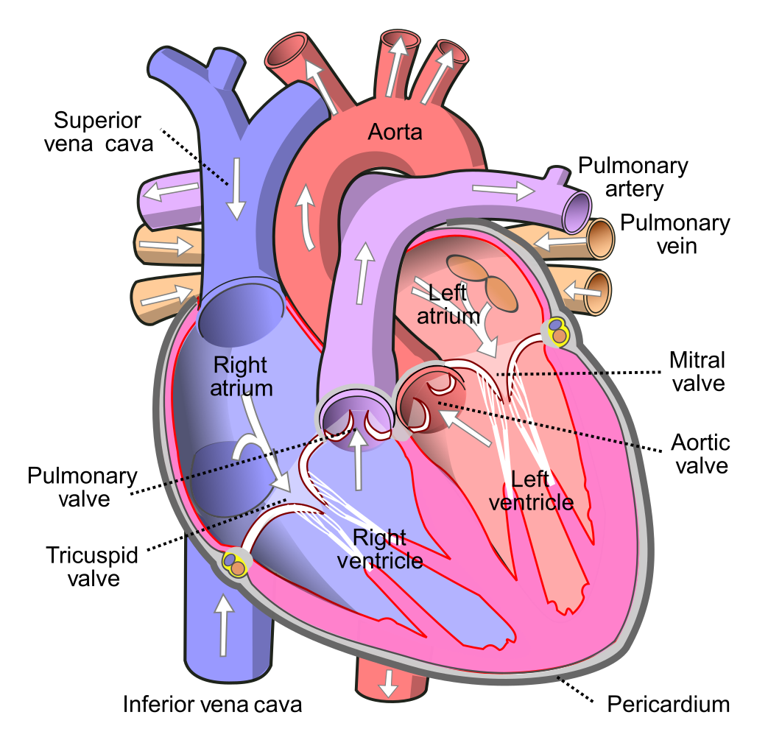
CLICK FOR VIDEO

Slide 7
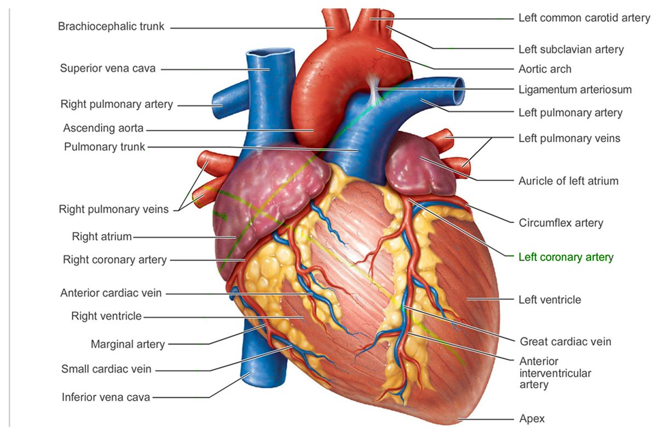

Slide 8
Human Circulatory System
The sinoatrial node (SAN) is present on the upper right corner of the right atrium and the atrioventricular node (AVN) is present at the lower-left corner of the right atrium
The AVN divides into right and left bundle at the interventricular septum and branches into minute fibres, that are present throughout the ventricle and are called Purkinje fibres
The nodal musculature is auto-excitable, i.e. it can generate action potential without any external stimuli
Bundle of His- Purkinje fibres along with the AV bundles form the bundle of His. It regulates the heartbeat and conducts the electrical impulses
The SAN is called ‘pacemaker’, it initiates and maintains the heart’s rhythmic activity. It can generate 70-75 action potentials per minute.

Slide 9
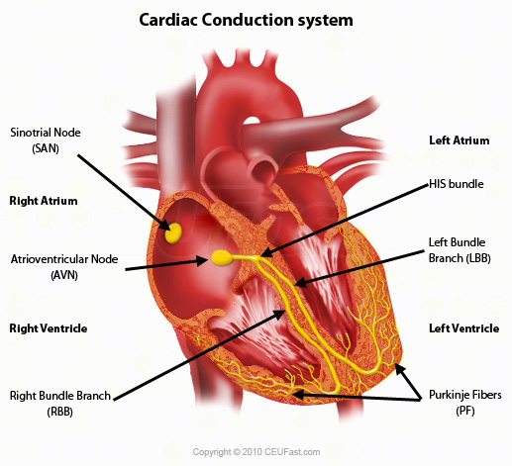

Slide 10
Blood Vessels
Arteries and veins are together called blood vessels, which transport blood to various parts of the body and bring back to the heart
Arteries and veins are made up of three layers
  Inner tunica intima – squamous endothelium
  Middle tunica media – elastic fibres and smooth muscles (thin in the veins)
  Outer tunica externa – fibrous connective tissue having collagen fibres

Slide 11
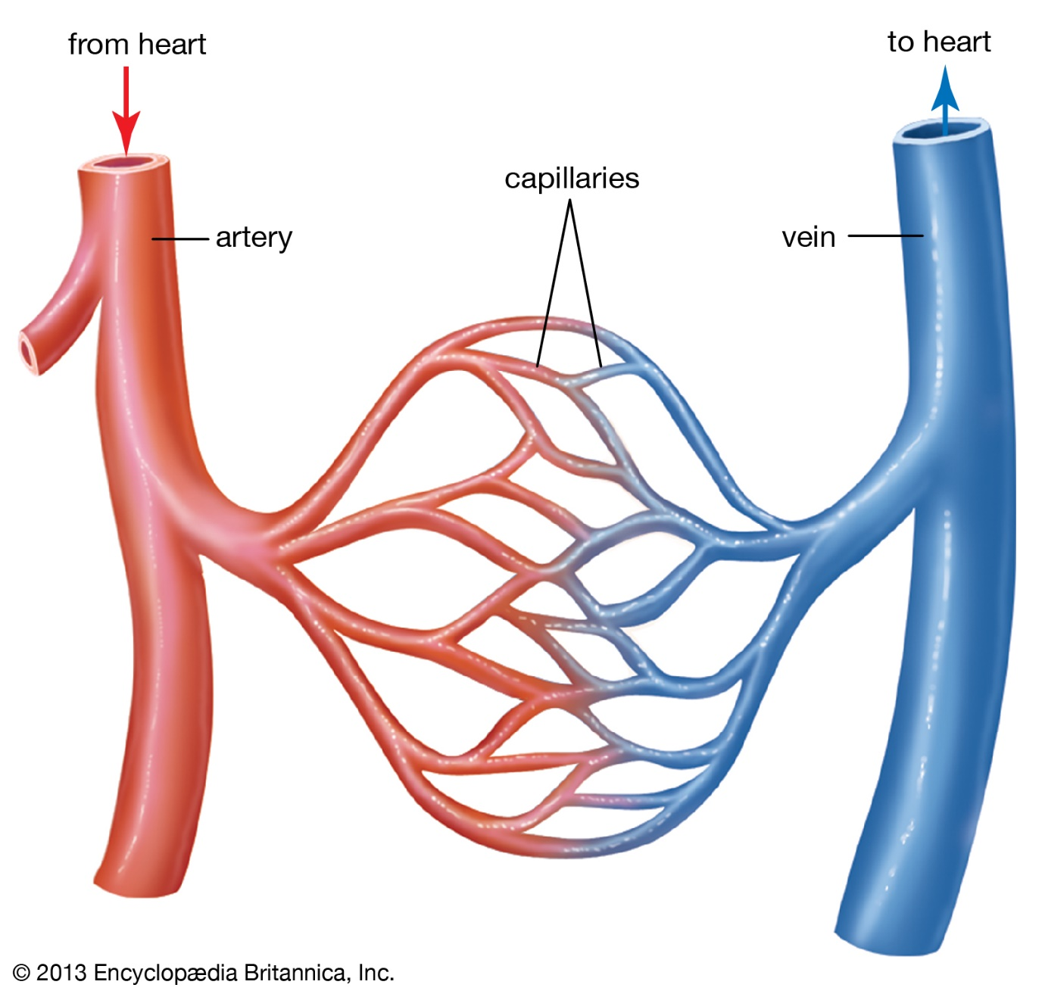

Slide 12
Blood Vessels – Arteries and arterioles
The arteries, which are strong, flexible, and resilient, carry blood away from the heart and bear the highest blood pressures.
Because arteries are elastic, they narrow (recoil) passively when the heart is relaxing between beats and thus help maintain blood pressure.
The arteries branch into smaller and smaller vessels, eventually becoming very small vessels called arterioles.
Arteries and arterioles have muscular walls that can adjust their diameter to increase or decrease blood flow to a particular part of the body.

Slide 13
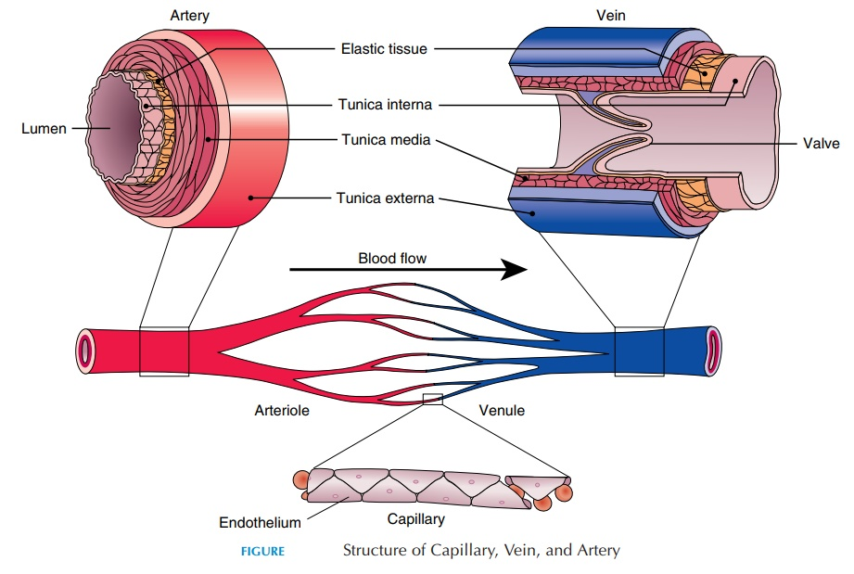

Slide 14
Blood Vessels – Veins
Blood flows from the capillaries into very small veins called venules, then into the veins that lead back to the heart.
Veins have much thinner walls than do arteries, largely because the pressure in veins is so much lower.
Veins can widen (dilate) as the amount of fluid in them increases.
Some veins, particularly veins in the legs, have valves in them, to prevent blood from flowing backward.
When these valves leak, the backflow of blood can cause the veins to stretch and become elongated and convoluted (tortuous). Stretched, tortuous veins near the body’s surface are called varicose veins.

Slide 15
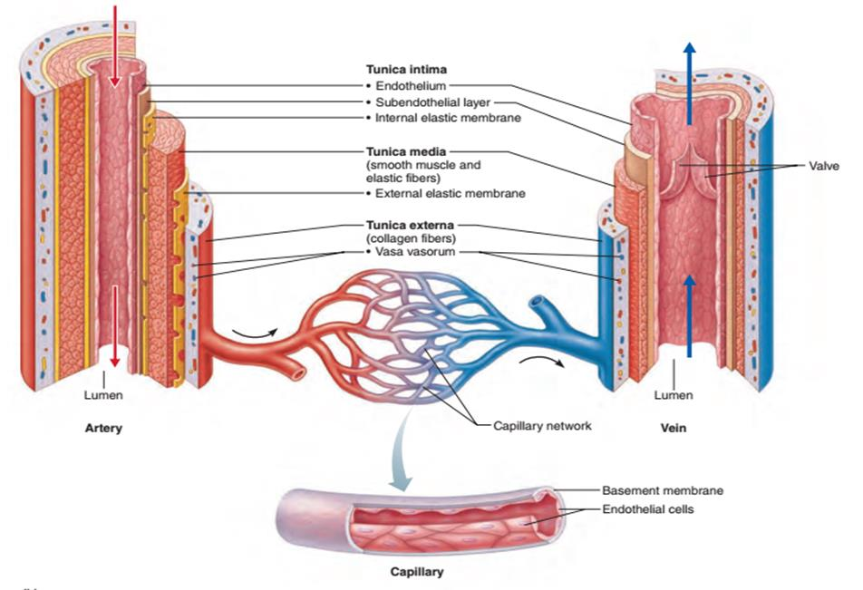

Slide 16
Blood Vessels – Capillaries
Capillaries are tiny, extremely thin-walled vessels that act as a bridge between arteries (which carry blood away from the heart) and veins (which carry blood back to the heart).
The thin walls of the capillaries allow oxygen and nutrients to pass from the blood into tissues and allow waste products to pass from tissues into the blood.

