Slide 1
SEXUAL REPRODUCTION IN FLOWERING PLANTS
CLASS XII

Slide 2
Flower - The Fascinating Organs of Angiosperms
A flower is a modified shoot for sexual reproduction.
Floriculture is the branch of ornamental, horticulture concerned with growing and marketing of flowers and ornamental plants, as well as with flower arrangement.
A flower is generally borne on the lateral side of the peduncle at a node in the axil of the leaf-like structure called bract.
A flower arising in the axil of a bract is called bracteate and if the bract is absent at the base of a flower the flower is called ebracteate.
The stalk of the flower is called pedicel and with pedicel the flower is called pedicellate and if the pedicel is absent the flower is sessile.

Slide 3
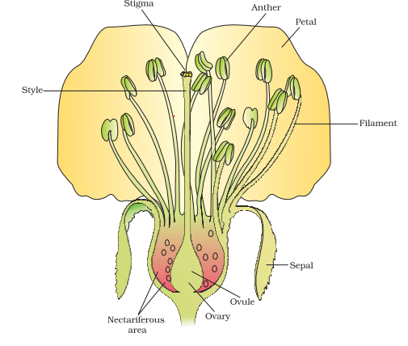
Parts of Flower
The pedicel has an upper swollen portion called thalamus (receptacle). It bears four types of floral leaves such as sepals, petals, stamens and carpels. In the group these whorls are called calyx, corolla, androecium and gynoecium.
In the flower the male and female reproductive structures, the androecium (whorls of stamens) and gynoecium (whorls of carpels) differentiate and develop
https://www.youtube.com/watch?v=kXjpZ8MROXs

Slide 4
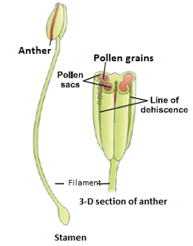
Male Reproductive Organ
The male reproductive organ is stamen/Androecium.
It consists of two parts:
Long and Slender stalk called filament.
A terminal, bilobed structure called anther.
Anther
A typical Anther is bilobed with each lobe having a theca, that is they are dithecous.
Each anther contains 4 microsporangium, that is, two in each lobe.
https://www.youtube.com/watch?v=RKnt3eUFjmg

Slide 5
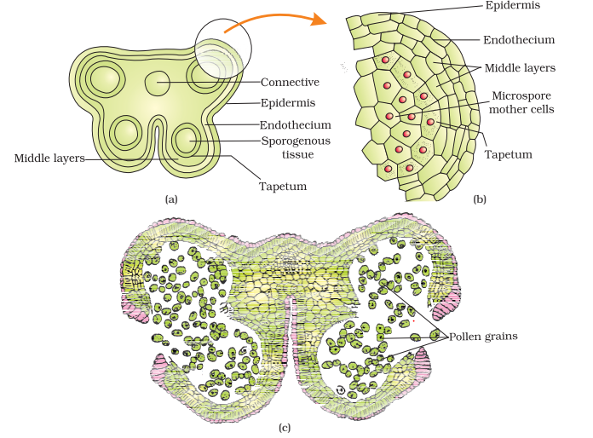
Structure of Microsporangium (Pollen sac):
A microsporangium is more often circular in outline and is surrounded by four wall layers:
  The outermost is the single layer of epidermis.
  The second layer is endothecium.
  Middle layers of 1-3 layers of cells.
  Tapetum, the innermost layer.
Tapetum nourishes the developing microspores or pollen grains; while other three wall layers provide protection.

Slide 6
Microsporogenesis & Formation of Pollen Grains
(Male Gametophyte):
Every cell of sporogenous tissue is a potential pollen mother cell (PMC) and can give rise to microspore tetrad.
The process of formation of haploid microspores from a diploid pollen mother cell through meiosis is called microsporogenesis.
Each Pollen mother cell undergoes mitosis to form a cluster of four cells called microspore tetrad.
As the anther matures, the microspores dissociate from the tetrad and develop into pollen grains (male gametophyte).

Slide 7
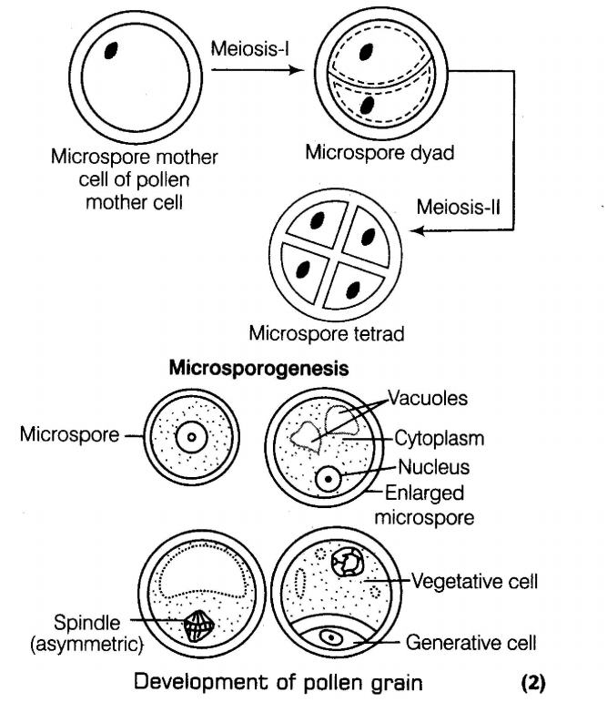
CLICK HERE FOR THE VIDEO

Slide 8
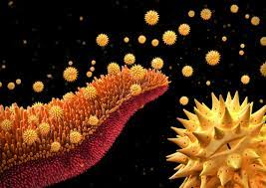
Development of Pollen Grain:
Pollen grain is a haploid unicellular body with a single nucleus.
The pollen grains represent the male gametophyte.
Each pollen grain has a prominent two-layered wall.
The outer layer is called exine and made up of sporopollenin.
The inner layer is called intine and made up of cellulose and pectin.

Slide 9
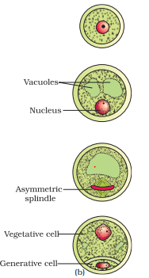
Development of Pollen Grain:
When pollen grain is mature, its nucleus undergoes mitosis to form a large vegetative cell (tube cell) and a small generative cell which floats in the cytoplasm of vegetative cell.
In 60% angiosperms, the pollen grains are shed at this two-celled stage. In certain species the generative cell divides mitotically to form two male gametes and the pollen grains are three-celled during liberation.

Slide 10
USES OF POLLEN
Pollen is used to manipulate plant traits.
Cross-pollination is the process of fertilization between similar plants to improve them.
Creating plants resistant to pests or dehydration or increasing crop production are a few changes made through cross-pollinating.
Pollen can also be used by archeologists to determine what ancient civilizations used for food.
Pollen is used in supplements to improve athletic performance or increase the strength of immune systems.
Pollen can also create a variety of allergic reactions in people--wind-carried pollen such as grass and ragweed are the most common culprits.

