Slide 1
SEXUAL REPRODUCTION IN FLOWERING PLANTS
CLASS XII

Slide 2
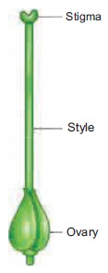
Female Reproductive Organ
Pistil/gynoecium/carpel represents the female reproductive unit of the plant.
It may consist of one carpel that is monocarpellary or more than one couple that is multicarpellary. When the number of carpel is more than one, the gynoecium may be syncarpous (joined/fused) or apocarpous (free).
Each carpel has three parts:
Ovary- The basal, swollen part in which ovules are present.
Style- The elongated filamentous part.
Stigma- Distal part which acts as a platform for lending of pollen grains.

Slide 3
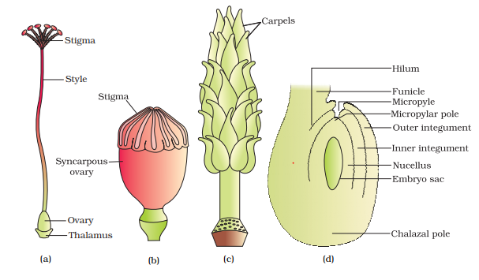
CLICK HERE FOR THE VIDEO, STRUCTURE OF FLOWER

Slide 4
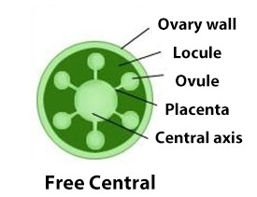
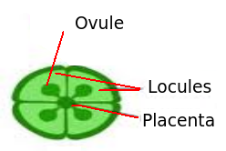
Female Reproductive Organ
The ovary encloses one or more cavities called the ovarian cavity or locule inside.
Placenta is the tissue seen in the locule that bears the ovule (megasporangium).
The number of ovules in the ovary may be one (for example: Mango, rice, wheat) or many ovules (for example: Watermelon, Banana etc.)

Slide 5
Development of Ovule And Female Gametophyte
The ovule is a small structure attached to the placenta by means of stalk called funicle.
The body of the ovule fuses with funicle in the region called helium.
The ovule contains a mass of thin walled parenchymatous cells called nucellus.
The nucellus is protected by two multicellular coats called integuments except the tip leaving a small opening called micropyle.
The basal portion of the nucellus is called chalaza that lies just opposite to the micropyle.
CLICK HERE FOR THE VIDEO

Slide 6
Development of Ovule And Female Gametophyte
Cells of nucellus are rich in reserve food material. There is generally a single embryo sac (haploid female gametophyte) located in the nucellus formed from the megaspore mother cell through meiosis.
Female gametophyte or embryo sac is embedded in the micropylar region of nucellus.

Slide 7
Megasporogenesis:
The process of formation of haploid megaspores from the diploid megaspore mother cell (MMC) is called megasporogenesis.
A single megaspore mother cell (MMC) is differentiated in the micropylar region of the nucellus of the ovule. This cell is large and contains dense cytoplasm and prominent nucleus.
The MMC undergoes meiosis and forms a cluster of four haploid cells called megaspore tetrad.
Three degenerate and only one megaspore becomes functional.
The functional megaspore enlarges to form embryo sac.
The method of embryo sac formation from a single megaspore is termed as monosporic development.

Slide 8
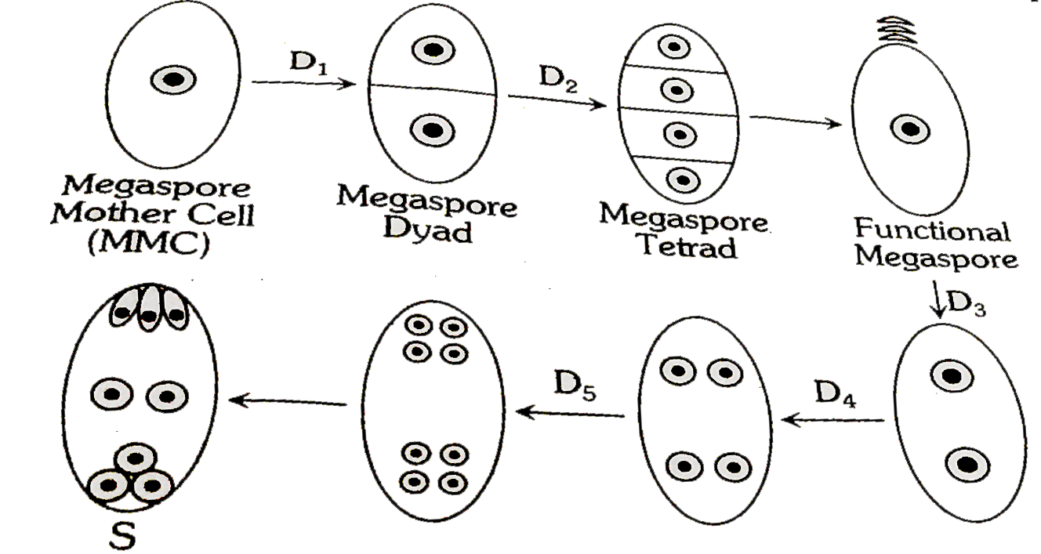

Slide 9
Development of female gametophyte:
The functional megaspore forms female gametophyte or embryo sac.
The nucleus of functional megaspore divides mitotically to form two nuclei which move to the opposite poles forming 2 nucleate embryo sac.
Two successive mitotic divisions in each of these two nuclei results in the formation of a 8-nucleate embryo sac.
Cell wall formation starts at the eight-nucleate stage, resulting in the formation of a typical female gametophyte or embryo sac.

Slide 10
Development of female gametophyte:
3 cells are grouped together at the micropylar end to form egg apparatus consisting of two synergids and one egg cell (female gamete).
3 cells are grouped together at the chalazal end and are called antipodals cells.
The remaining two nuclei are called polar nuclei, they move to the centre of embryo sac and fuse to form diploid secondary nucleus (Central cell).
Hence, a typical angiosperm embryo sac (female gametophyte) is 8- nucleate and 7-celled.

Slide 11
