Slide 1
SEXUAL REPRODUCTION IN FLOWERING PLANTS
CLASS XII

Slide 2
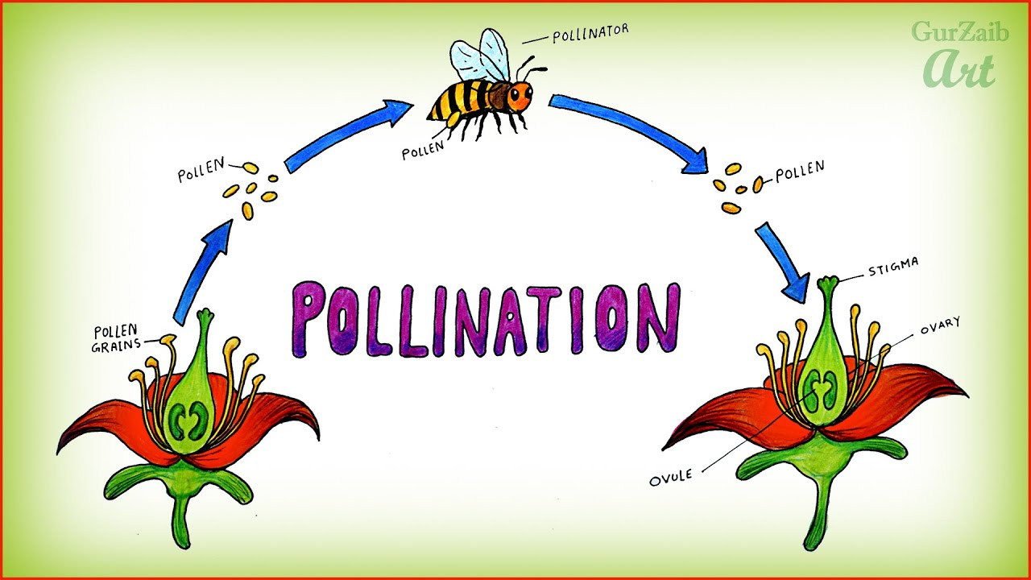

Slide 3
POLLINATION
Pollination is necessary as the pollen grains continue their development only when they fall on a suitable stigmatic surface.
It is the phenomenon of transfer of pollen grains from anther to Stigma of the carpel.
Depending upon the source of pollen grain pollination is a following types:
Self pollination
Cross pollination

Slide 4
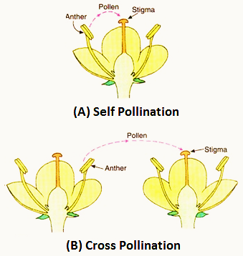
SELF & CROSS POLLINATION

Slide 5
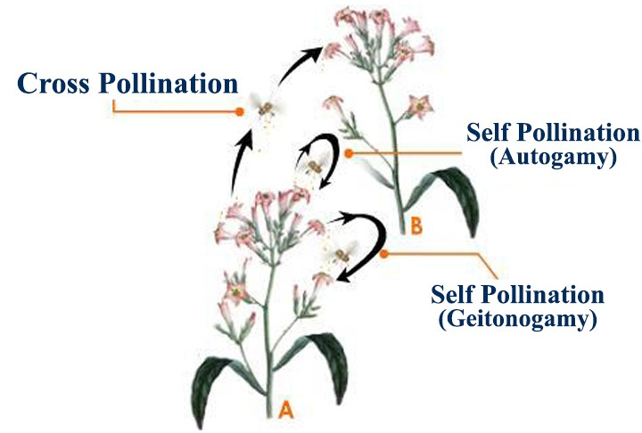
TYPES OF POLLINATION ON THE BASIS POLLINATION

Slide 6
TYPES OF POLLINATION ON THE BASIS POLLINATION
Autogamy
It is the transfer of pollen grains from anther of a flower to the stigma of the same flower.
Geitonogamy
When pollen from one flower are deposited on the stigma of another flower borne on the same plant.
Xenogamy/Allogamy
Cross pollination can also be defined as the migration of pollen grains from one flower to the stigma of genetically different flowers.
For example: Pea, Wheat, Rice etc.
For example: Cucurbits.
For example: Date palm, Papaya etc

Slide 7
Agents for pollination
ABIOTIC
WATER
WIND

Slide 8
Agents for pollination
Abiotic agents:
The pollen grains are dry and un-wettable.
Wind pollinated flowers bear well exposed stamens.
To catch the pollen grains the stigma becomes sticky, hairy, feathery or branched.
Anemophilous flowers usually bear a single ovule in each ovary
Anemophily is the process when pollen is transported by air currents from one individual plant to another. These plants possess the following characteristic features:

Slide 9
Agents for pollination
Abiotic agents:
These flowers can float on water surface
The pollen grains are small and have more volume than its mass
The stigma is broad to easily capture the flowing pollen grains
Pollen grain are resistive to water so that water can not damage
Pollen grain is sticky
Hydrophily is the process when pollen is transported by water currents from one individual plant to another. These plants possess the following characteristic features:

Slide 10
Agents for pollination
Chiropterophily
Ornithophily
Entomophily

Slide 11
Agents for pollination
Biotic agents:
Majority of insect pollinated flowers are large, colourful, fragrant and rich in nectar. For example Jasmine, Cestrum etc.
To catch the pollen grains, the stigmas become sticky.
Flowers become more conspicuous by grouping e.g. capitulum, corymb, etc.
In plants like Papaver, Rosa etc. edible pollen grains are produced.
Entomophily (Insects pollinated plants): Insects particularly bees are dominating biotic pollinating agents. Entomophilous plants possess the following characteristic features:

Slide 12
Agents for pollination
Ornithophily: The bird pollinated flowers are generally scentless, large in size. They are also beautifully coloured. The pollens are sticky and adheres to the body of the bird. For example Coral tree, Bottle brush etc.
Chiropterophily: The flowers of Durio, Kigella pinnata are pollinated by bats. The bats hold on to the freely exposed, large and relatively tough flower, which open in the evening or night.

Slide 13
Significance of pollination
Male and female gametes in angiosperms are produced in the pollen grain and embryo sac respectively.
As both male and female gametes are non-motile, they have to be brought together for fertilization to take place. This aim is achieved by the process of pollination.

Slide 14
Devices favouring Self-Pollination
There are two devices
Homogamy: It is the condition in which anther and stigma in bisexual flower attain maturity at the same time.
Cleistogamy: In this, flower never open to expose their sex organs and the pollens fall on the stigma of the same flower. Such flowers are called cleistogamous flowers. For example: Commelina, Oxalis, Viola etc.
Note: Chasmogamous flowers are with exposed anthers and stigma.

Slide 15
Devices favouring Cross-Pollination
Outbreeding devices promoting cross-pollination:- Flowering plants have developed many devices to discourage self-pollination and to encourage cross-pollination.

Slide 16
Devices favouring Cross-Pollination
Pollen release and stigma receptivity are not synchronized.
The anther and stigma are placed at different positions.
Self-incompatibility.

Slide 17
Devices favouring Cross-Pollination
In some species pollen release and stigma receptivity are not synchronized. Either the pollen is released before the stigma becomes receptive (protandry) or stigma becomes receptive much before the release of pollen (protogyny).
In some other species , the anther and stigma are placed at different positions so that the pollen cannot come in contact with the stigma of the same flower.
The third device to prevent inbreeding is self-incompatibility. It is a genetic mechanism that prevents the germination of pollen grain on the stigma of the same flower.

Slide 18
Pollen-Pistil Interaction
Recognition Of Compatible pollen:
The stigma/pistil has the ability to recognize the right type of pollen i.e. the compatible pollen of the same species.
It is the result of interaction between the chemical component of the pollen and those of stigma.

Slide 19
Germination of pollen grains and development of male gametophyte:
Germination of pollen grains and development of male gametophyte:
A compatible pollen grain germinates on the stigma to produce a pollen tube through one of the germ pores.
The contents of the pollen grain move into the pollen tube that is the tube nucleus and two male gametes (generative cell).
The pollen tube grows through the tissues of the stigma and style and enters the ovule through micropyle.

Slide 20
Germination of pollen grains and development of male gametophyte:
It enters the embryo sac through the filiform apparatus of one of the synergids to liberate the male gametes.
The germinated pollen grain with its full grown pollen tube carrying a tube nucleus at its tip and two male gametes is the fully developed male gametophyte of angiosperms.
The events from the deposition of pollen on the stigma till the pollen tube enters the ovule are collectively referred to as pollen-pistil interaction

