Slide 1
SEXUAL REPRODUCTION IN FLOWERING PLANTS
CLASS XII

Slide 2
Double fertilization
The pollen tube releases the two male gametes into the cytoplasm of a synergids.
One of the male gametes moves towards the egg cell and fuses with its nucleus, this fusion is called syngamy and it results in the formation of a diploid cell, the zygote that later develops into the embryo.
The second male gamete fuses with the secondary nucleus in the central cell to produce a triploid primary endosperm nucleus (PEN), this fusion is called triple fusion as three haploid nuclei are involved in the fusion.
Since two fusions, syngamy and triple fusion occur in an embryo sac, the phenomenon is known as double fertilization and it is unique to angiosperms.
The central cell with the primary endosperm nucleus is now called primary endosperm cell (PEC) and develops into endosperm.

Slide 3
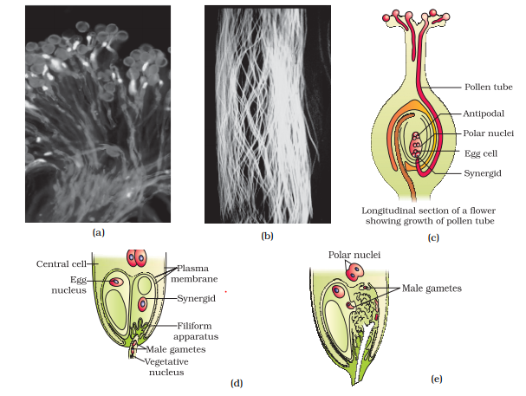
Double fertilization

Slide 4
Post -fertilization events
1
Development of endosperm
2
Development of embryo
3
Maturation of ovule into seed
4
Maturation of ovary into fruit

Slide 5
Development of Endosperm
Endosperm development precedes embryo development. There are three methods for this:
Nuclear type
Cellular type
Helobial type
The most common is the nuclear time, where triploid primary endosperm cell undergo repeated mitotic division without cytokinesis. At this stage, the development of endosperm is called free nuclear development. For example: coconut water.
Subsequently, cell wall formation occurs and the endosperm becomes completely cellular. For example: white part of coconut.

Slide 6
Development of Endosperm
The cells of endosperm store food material which are later used by developing embryo.
The endosperm which may be completely utilized by the developing embryo before the maturation of seed as in pea, bean, mustard; such seeds are called albuminous or non -endospermic seeds.
In some species a portion of endosperm may remain in the mature seeds, for example: maize, coconut, rice; such seeds are called albuminous or endospermic seeds.

Slide 7
Development of embryo
The embryo formation stars after a certain amount of endosperm is formed as there is an assured supply of nutrition to the embryo.
The zygote divides mitotically to give rise to proembryo first and then subsequently to the globular, then heart -shaped and ultimately becomes horseshoe shaped mature embryo with one or more cotyledon.

Slide 8
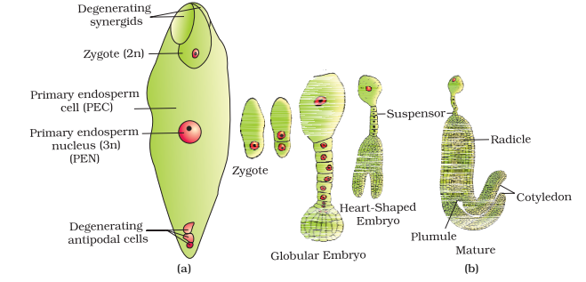

Slide 9
Differences between dicotyledonous and monocotyledonous embryo
Monocot vs Dicot Embryo
The monocot embryo is the embryo with the presence of only one cotyledon. | The dicot embryo is the embryo of dicot plants that contain two cotyledons.
Cotyledon
A single cotyledon is present in monocot embryo. | Two cotyledons are present in dicot embryo.
Position of the Cotyledons
They occur terminally in monocot embryo. | They occur laterally in dicot embryo.
Plumule
Plumule is present laterally in monocot embryo. | Plumule is present distally in dicot embryo.
Coleoptile
Coleoptile (envelope of the plumule) is present in monocot embryo. | No coleoptile is present in dicot embryo.
Coleorrhiza
Radicle protective sheath ( coleorrhiza ) is present in monocot embryo. | Coleorrhiza is absent in dicot embryo.
Scutellum
Scutellum is present in monocot embryo. | Scutellum is absent in dicot embryo.
Suspensor (Size)
Monocot embryonic suspensor is comparatively larger than the dicot suspensor. | Dicot suspensor is larger but smaller than the monocot.

Slide 10
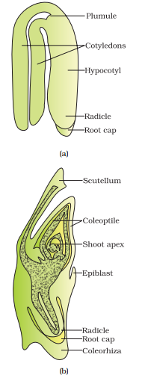
DIAGRAM OF MONOCOT & DICOT EMBRYO

Slide 11
SEED
A seed is a ripped, fertilized ovule.
It consists of a seed coat, cotyledons and embryonal axis.
Seed coat is double layered formed by integuments.
Micropile is a small opening found on seed coat. It facilitates the entry of water and oxygen into the sea during germination.
The cotyledons are generally thick and swollen with food material.
As the seed matures, the water content is reduced and the seed becomes dry. The embryo enters a state of inactivity called dormancy.

Slide 12
Advantage of seeds:
In plants:
Seeds have better adaptive strategies for dispersal to new habitat for better survival.
Seeds have reserve food material to nourish the seedling during germination.
The hard seed coat provides protection to young embryo.
Seeds are produced after sexual reproduction, they show genetic recombination leading to variation.

Slide 13
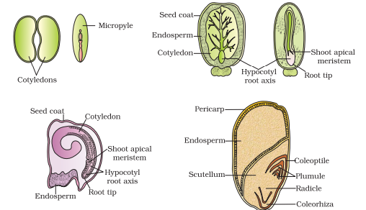
CROSS SECTION OF SEED

Slide 14
Development of fruits
Fruits may be defined as the mature form of ripened ovary.
The ovary begins to enlarge simultaneously with the development of seed and ultimately become the fruit.
The ovary wall becomes the fruit wall called pericarp, which helps in the disposal of seeds.

Slide 15
Types of Fruits:
TRUE FRUITS
MANGO
KIWI
WATER MELLON
True fruits: The fruits derived from the ovary of a flower not associated with any non-carpellary part is termed as true fruit, for example- Mango and tomato. The other floral parts degenerate and fall-off.

Slide 16
Types of Fruits:
FALSE FRUITS
STRAWBERRY
BANANA
APPLE
False fruits: The fruit derived from ovary along with other accessory floral parts like thalamus is called false fruit, for example- Apple cashew nut, strawberry etc.

Slide 17
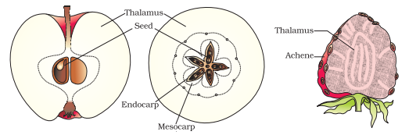
FALSE FRUIT

Slide 18
Parthenogenesis
Parthenogenesis is the formation of an embryo directly from the female gamete or egg cell.
Haploid parthenogenesis is found in Solanum nigrum (Brinjal).

Slide 19
Polyembryony
Some angiosperms produce more than one embryo in a seed. This is known as polyembryony. It was first noticed by Lewenhoek in seeds of oranges.
Various types of polyembryony are:
Cleavage- for example; Nicotiana rustica
Embryos from cells of embryo sac other than egg- for example; Argemone mexicana (dry nut).
Embryo arises from cells outside embryo sac- for example; Citrus.
Embryo from endosperm- for example; Alnus.
Other examples are onion groundnut, mango etc.

Slide 20
Apomixis
It is a form of asexual reproduction that mimics sexual reproduction but produces seeds without fertilization.
It does not involve formation of zygote through the gametic fusion.
It occurs in some species of Asteraceae and grasses.
Apomictic seeds are viable seeds produced without pollination or sexual reproduction.
These are produced from segments of fruits (Mango stem), male gametic content of pollen (Cyperus) and other vegetative parts.
Apomixis is extensively used in the hybrid seed industry. As production of hybrid seeds is costly, so if hybrids are made into apomicts, there is no segregation of character in the hybrid progeny.
Then the farmer need not buy hybrid seeds year after year and can use apomictic seeds to raise new crops every year.

Slide 21
Artificial hybridization:
In this, crossing is made in such a way that only desired pollen grains are utilised for the process of pollination. The stigma is protected from contamination by unwanted Pollen.
This is achieved by emasculation and bagging.
Emasculation: Removal of anthers from floral buds before the anther dehisces using a forcep is called emasculation.
Bagging: When emasculated flowers are covered by bags of suitable size usually made up of butter paper to prevent contamination of its stigma with unwanted pollen is called bagging.
After, pollen grains from desired male gamete are dusted on stigma and then the flowers are rebagged.
It is one of the major approach of the Crop program

Slide 22
Incompatibility:
It is the ability of functional male and female gametes to affect fertilization in particular combinations.
It is the interior part of pollen pistil interaction.
It is either interspecific or intraspecific.
Self incompatibility (intra- specific): In this, fertilization is prevented between gametes which originate from the same individual and some other individual of the same species.
Significance:
It may be used in hybrid seed production.
In nature, inbreeding and outbreeding of plants is regulated by self incompatibility.

