Slide 1
CLASS – 12
SUBJECT – BIOLOGY
CHAPTER – 8
CONCEPT – HUMAN HEALTH & DISEASE
PPT – 1

Slide 2
HEALTH AND DISEASES
Health
According To WHO, health is defined as
“ Health is a state of complete physical, mental and social well-being and not merely an absence of disease or physical fitness.
Health is a state of body when all the organs and systems are functionally properly and a perfect balance is maintained b/w the environment and body.
Diseases
Any conditions which interferes with the normal functioning of the body and impairs the body is called disease.

Slide 3
Types of diseases
On the basis of their period of their occurrence.
Congenital disease
These are inborn diseases which are present from birth and generally inherited.
Example
Disease caused by gene mutation (colour blindness) and chromosomal mutation (Down Syndrome).
Acquired diseases
These occur only after birth and are non- inherited.
On the basis of their communication, acquired diseases are of 2 types:
Communicable/ infectious
Non- communicate/ Non- infections

Slide 4
Communicable:
These can be transmitted from an infected person to the healthy person by means of air, water, food and physical contact or vectors.
Depending upon the causative agent, communicable disease are of following types:
Bacterial Diseases: (Typhoid Pneumonia, Tuberculosis etc.)
Viral Diseases: (Dengue, Polio, influenza, AIDs, measles etc.)
Protozoan Diseases: (Malaria, amoebiasis, Kala azar, sleeping sickness etc).
Helminths Diseases: (Ascariasis, Elephantiasis, Prichinosis etc.)
Fungal Diseases: (Ringworm, athlete’s foot)
Rickettsial Diseases: (Typhus fever, Trench fever etc.)

Slide 5
On the basis of their mode of transmission, communicable diseases are of two types:
Contagious diseases: (Direct contact)
These communicable diseases can spread from infected people to healthy people by actual contact b/w them.eg. STDs, smallpox, chicken pox etc.
Non-contagious diseases: (Indirect contact)
These communicable diseases can spread from healthy people to infected people with food, air or water. Eg. Typhoid, Cholera or by microorganisms enters through host (eg. Malaria).
Non-communicable Diseases:
These do not spread from an infected person to a healthy person. These are of 4 types.
Deficiency disease- Diabetes mellitus, Kwashiorkor (protein)
Degenerative disease- eg. Cardiovascular Arthritis
Cancerous diseases
Allergies- Asthma, fever

Slide 6
Pathogen These are such microorganisms like bacteria, viruses and fungi which could cause disease in humans.
Means of Spread:
Direct transmission: direct contact with an infected person (STDs), droplet infection (common cold), contact with soil (tetanus), animal bite (rabies) and transplacental transmission (syphilis).
Indirect transmission: Vector borne diseases (eg. Malaria), contaminated food and water (cholera), Air borne (influenza), Formite borne, uncleaned hand (ascariasis).
Prevention of diseases ( Prophylaxis):
There are 3 limitations of the treatment approach of infectious diseases.
Body functions may never recover completely.
Patient is bed- ridden for some time depending on the severity of disease.
Infected people act as the source of spread of disease to even healthy person.
So, it is right to say that "Prevention is better than cure".

Slide 7
There are 2 ways of Prophylactic measures:
General prophylactic measure:
Avoid overcrowding and providing hygienic living conditions.
Providing safe drinking water.
Proper sanitation of human foetus.

Slide 8
Some Important Protozoan Diseases
Amoebiasis: (Amoeboid dysentery)
Causative agent: Entamoeba histolytica (protozoa)
Epidemiology: Direct and oral and sometimes by vectors (house- flies).
Symptoms: Ulceration, acute diarrhea, abdominal pain, stools with excess mucus and blood clot.
Prevention/control: Antibiotics like paramycin, erythromycin. Aureomycin and most effective metronidazole.
Site of effect: Pathogen secretes cytolysin enzymes which damage intestinal mucosa.
Malaria:
Causative agent: Plasmodium- P. vivax, P. malariae, P-falciparum (malignant malaria).
Epidemiology: Oral contact and by vector like female anopheles mosquito.
Symptoms: Fever, weakness, headache
Prevention/control: Durg quinine (extracted from bark of Cinchona plant).

Slide 9
LIFE CYCLE OF PLASMODIUM
Life Cycle of Plasmodium
It is Digenetic (2 hosts):
Man (secondary)
Anopheles (primary)
Life cycle of plasmodium is Triphasic.
Schizogony
Gamogony
Sporogony

Slide 10
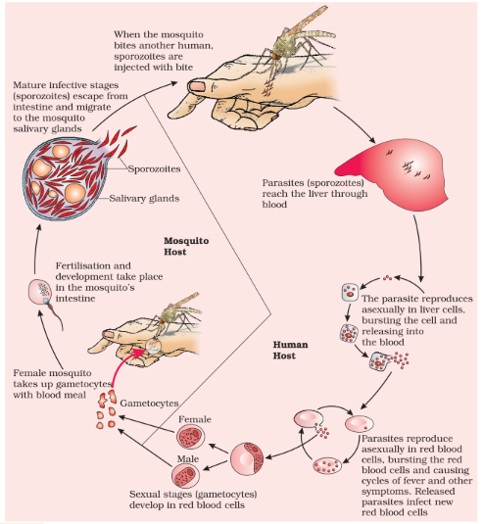

Slide 11
Some Important Helminth Diseases
Ascariasis:
Caused by: Helminthes; Ascaris lumbricoides
Symptoms: internal bleeding, blockage of intestinal passage, anaemia, muscular pain.
Epidemiology: contaminated vegetables, fruits, soil etc.
Control (prophylaxis): Mixture of oil of chenopodium and tetrachloroethylene.
Filariasis (Elephantiasis)
Caused by: Wuchereria bancrofti and Wuchereria malayi
Symptoms: Normally caused inflammation of organs, affects the lymph vessels of lower limbs, genital organs are also affected resulting in gross deformities.
Epidemiology: female culex mosquito is the vector.
Control: Anti-helminth drugs like Hetrazin and Diethylcarbamazine.

Slide 12
IMMUNITY
Immunity or disease resistance is the ability of an organism to resist the development of a disease.
The study of immunity is called immunology; while the infected person with no disease is known as immune.
Immune system forms the third line of defense.
Any foreign substance which when enters the body, is capable of stimulating an immune response is called an antigen.
The protective chemicals produced by the body in response to antigens are known as antibodies.
Antibodies are a class of bodies called immunoglobulins.
Immunity is of two types:
(a) Innate immunity
(b) Acquired immunity

Slide 13
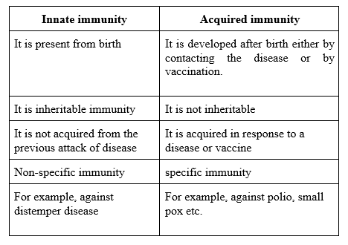

Slide 14
Innate Immunity
It is a non-specific type of defense that is present at the time of birth.
This is accomplished by providing different types of barriers to the entry of the foreign antigens into our body.
It consists of following barriers:
Physical barriers:
They include skin and mucus coated epithelium of the respiratory tract, gastro- intestinal and urino-genital tract where the mucus helps in trapping microbes entering our body.
Physiological barrier: They include
Acidity of stomach
Lysozyme in saliva
Tear from eyes
All prevent microbial growth.

Slide 15
Innate Immunity
Cellular barrier:
They include the following specialized cells, which phagocytose and destroy the microbes.
Natural killer lymphocytes
Neutrophils
Monocytes
Macrophages
Cytokine barrier:
Interferons produced by viral infected cells protect the non- infected cells from viral infections.

Slide 16
Acquired immunity (Adaptive Immunity)
Acquired immunity refers to the immunity, a person acquires after birth; either by contacting the disease or by vaccination.
It is pathogen specific and is present only in vertebrates. It has the following characters:
Specificity
It has the ability to distinguish many different foreign molecules.
Memory:
When the immune system encounters a pathogen for the first time, it develops an immune response by which a pathogen is eliminated (primary response). It also retains some memory cells which evoke a heightened immune response in further encounters (secondary response).

Slide 17
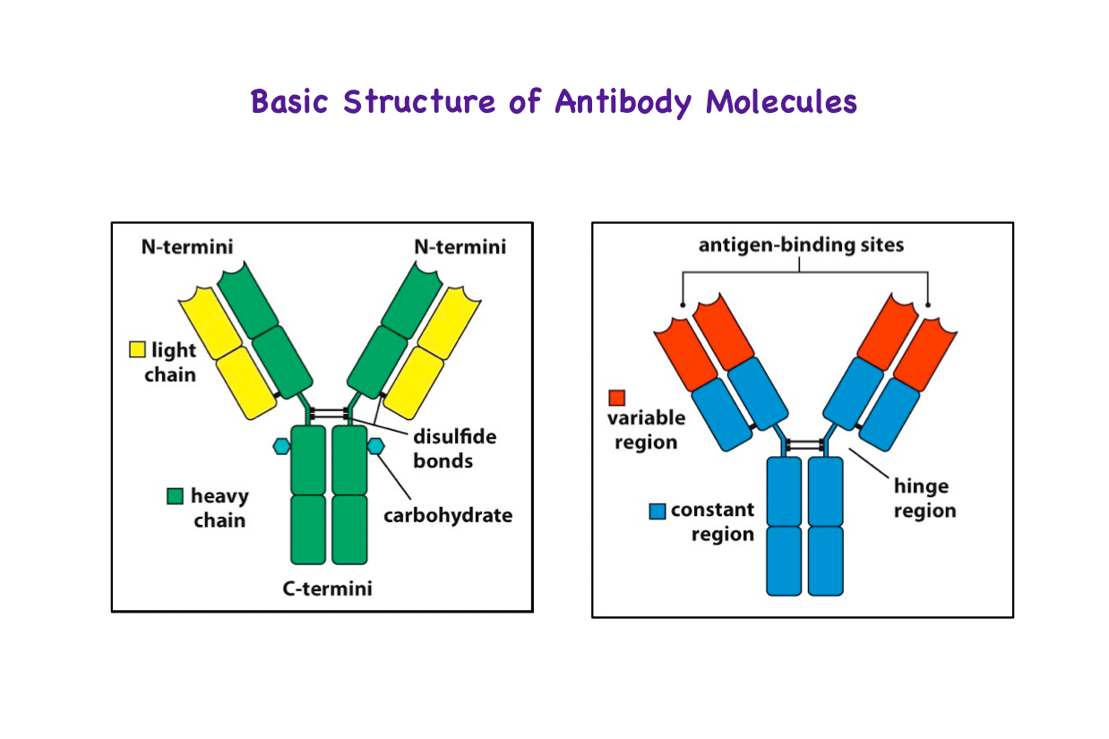

Slide 18
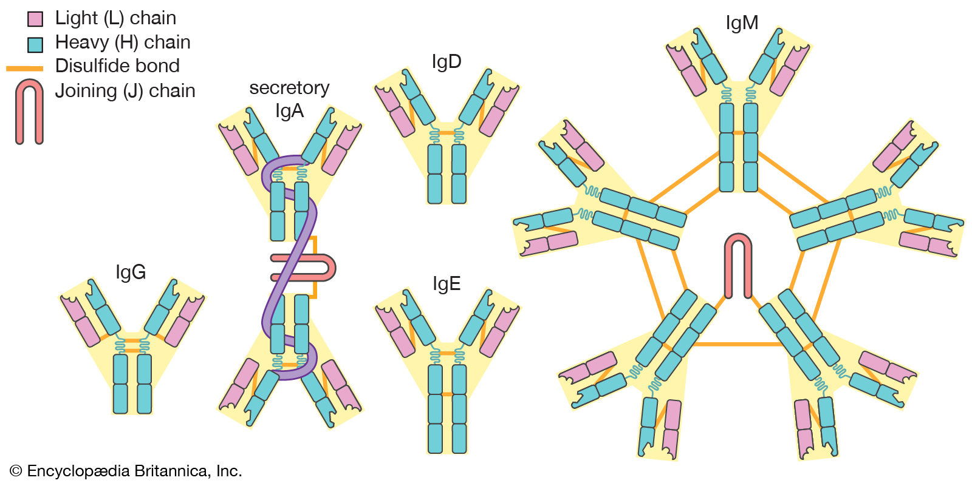

Slide 19
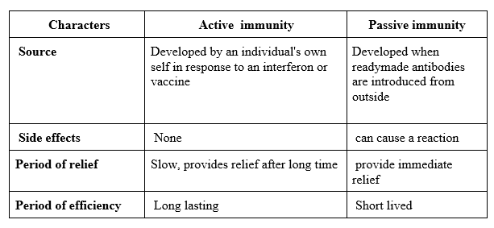

Slide 20
Vaccination and Immunization
The principle of vaccination and immunization is based on the property called memory of the immune system.
The vaccines generate antibodies that neutralize the toxin/pathogen and also produce memory B-cell and T-cell which recognize the pathogen in subsequent encounters and produce antibodies. This type of immunization is called active immunization.
If a quick immune is needed as in tetanus infection, preformed antibodies or antitoxin injected into the patient. This type of immunization is called passive immunization .
Recombinant DNA technology has allowed the production of antigenic polypeptides of pathogens in other microbes like yeast and bacteria. Eg. Hepatitis-B vaccine is produced using yeast cells.

Slide 21
ALLERGY
Allergy:(Hypersensitivity):
Allergy can be defined as the hyper- sensitive reaction of the immune system of a person to some foreign substances called allergen which either comes in contact with or enters the body.
The antibodies produced in response to allergens are IgE type.
The common symptoms of allergy:
  Rashes
  Sneezing
  Watery eyes
  Running nose
  Difficulty in breathing.
These symptoms are produced due to release of histamine and serotonin from the mast cells.
Drugs like anti- histamine, adrenaline and steroids quickly reduce the symptoms of allergy.

Slide 22
Auto- Immunity:
The auto- immune disorders are those disorders caused by the bodies of the immune system when it goes off the track and starts destroying “self- cells and molecules”.
Eg. Hashimoto’s thyroiditis, insulin-dependent diabetes, Rheumatoid arthritis etc.
Immune System
The main function of the immune system is to recognize the foreign molecules, respond to them and keep a memory of them.
It also play a role in
Organ transplantation
Allergic reactions
Auto- immune diseases
Immune system consists of following:
Lymphoid organs, Bone Marrow, Thymus, Spleen, Lymph nodes, Mucosa associated lymphoid tissue (MALT)

Slide 23
AIDS
AIDS (Acquired Immunodeficiency Syndrome)
It was first reported in 1981.
It is caused by human Immunodeficiency Virus. (HIV) which is a retrovirus (single stranded RNA)
Transmission of HIV occurs in one of the following ways:
By sexual contact with an infected person.
Transfusion of contaminated needles.
From infected mother to child through placenta.
The following individual are at high risk of giving disease:
Those who have multiple sexual partners.
Drug addicts taking drugs intravenously.
Individual who requires repeated blood transfusion.
Children born to an infected mother.

Slide 24
LIFE CYCLE OF HIV
The virus after getting into the body of a person enters the macrophages.
The RNA replicates and DNA is formed by reverse transcriptase. (reverse transcription)
The viral DNA gets incorporated into the host cell DNA to form prophage and replicates along with host DNA and direct the infected cell to produce virus particles.
The macrophages continue to produce virus particles. Finally the infected host cell is lysed and many HIV viruses are released which infect helper- T cells, replicates and form progeny virus. So, the process is repeated which caused a progressive decrease in the number of helper T- cells. Now the person becomes easily infected by bacteria like mycobacterium, viruses and even parasites like Toxoplasma.
The person is unable to protect himself/ herself against any infection.

Slide 25
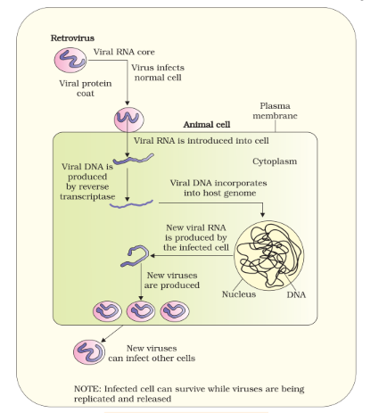

Slide 26
Diagnosis:
AIDS can be diagnosed by ELISA (Enzyme Linked Immunosorbent Assay) and Western blot test.
Prevention:
National AIDs control organizations (NACO) and NGOs are trying their best to educate people about AIDs.
WHO has started a number of programs to prevent spreading of HIV infection. Some such steps include
Ensuring use of disposable needles and syringes.
Checking blood for HIV.
Controlling Drug Abuse.
Promoting regular checkup for HIV in susceptible populations.
Avoiding prostitution, multi- partner sex and homosexuality etc.

Slide 27
CANCER
CANCER
Cancer is characterized by uncontrolled growth and division of certain body tissues, so forming a tumor.
Transformation of normal cells into cancerous cells is induced by carcinogen
The cancer cells differ from the normal cells in the following ways:
There is a breakdown of regulatory mechanisms which control normal cell growth, division and differentiation.
Cancer cells do not show contact inhibition and show uncontrolled growth.
Cancer cells show metastasis. ie. They detach from the tumor and move to distant sites through body fluid and develop secondary tumor

Slide 28
Types of tumor:
Benign Tumor:
They remain confined to their original location and do not spread to other parts, they cause little damage.
Malignant Tumor:
They are masses of neoplastic/ proliferating cells, which grow rapidly, invade and damage the surrounding normal tissue/ cells. These cells complete with the normal cells for vital nutrients and disrupt normal metabolism. These cells show the property of metastasis.

Slide 29
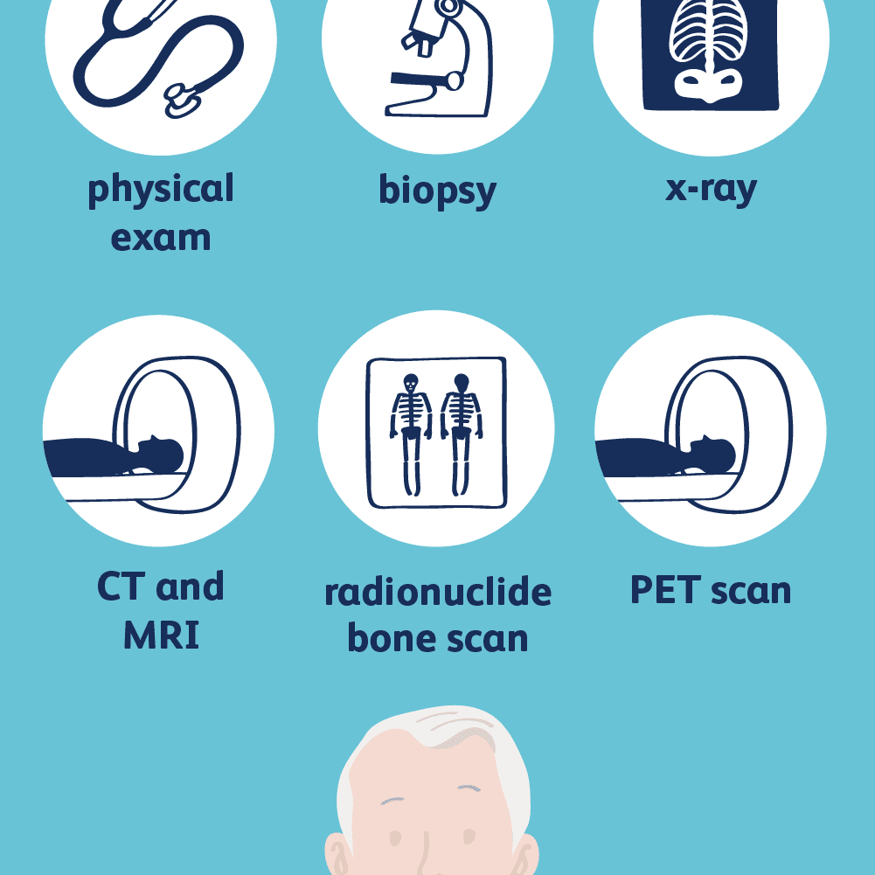
Diagnosis of Cancer:
Cancer can be detected by:
Biopsy and Histopathological studies of tissue.
Blood and Bone Marrow test for increased cell count as in leukemia (blood Cancer)
Use of techniques like radiography, Magnetic resonance imaging (MRI) and computed Tomography (CT) for cancer of internal organs.
Use of antibodies against Cancer- specific antigens.
Applying principle of molecular biology to detect genes in individuals with inherited susceptibility to certain cancer.

Slide 30
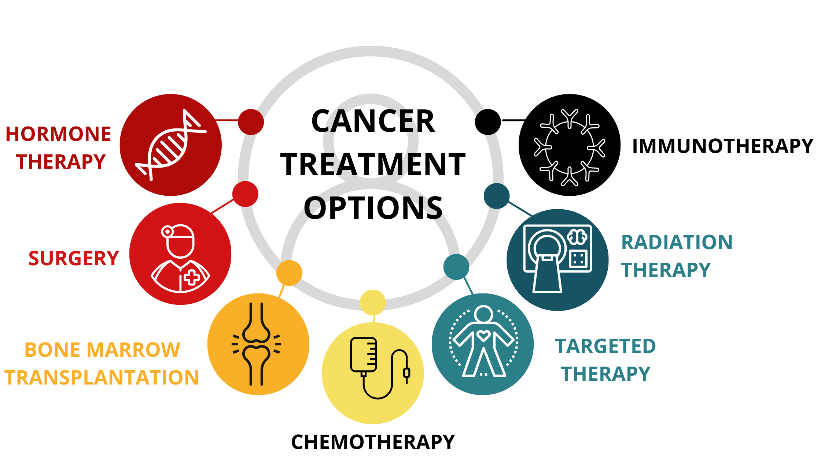

Slide 31
Treatment of Cancer:
The following one or more methods in combination can help to treat cancer:
Surgery:
The tumor cells are surgically removed to reduce the load of cancerous cells.
Radiotherapy:
The tumor cells are irradiated wholly but taking care of normal surrounding cells.
Chemotherapy:
Certain drugs are used to kill the cancerous cells, but the majority of drugs have side-effects such as hair-loss, anemia etc.
Immunotherapy
This involves the use of biological response modifiers like alpha-interferons as monoclonal antibodies which activates the immune system and helps in destroying tumors.

Slide 32
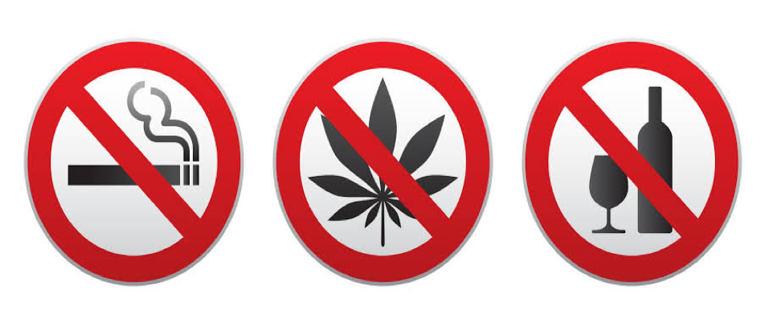
DRUGS AND ALCOHOL ABUSE
Drug Abuse
The drugs that are commonly abused include opioids, cannabinoids, cola-alkaloids, barbiturates, amphetamines, benzodiazepines and Lysergic acid diethylamide (LSD).

Slide 33
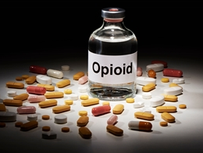
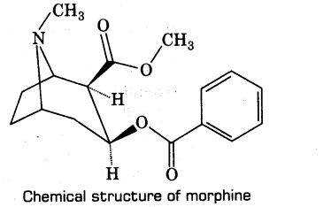
Kinds of drugs:
1.Opioids: These act as depressants and analgesics so are commonly called pain-killers.
These bind to their specific opioid receptor present in the CNS and gastro-intestinal tract.
eg. Morphine and heroin (derivatives of opium).
Morphine: It is obtained from the latex of poppy plant (Papaver somniferum).
It is used to reduce pain after surgery.
Heroin (smack): Also called brown sugar It is chemically called Diacetylmorphine. It is a bitter, white, odorless, crystalline compound obtained by acetylation of morphine.
It is generally taken by smoking and injection.
It is depressant and slows down the body functions.

Slide 34
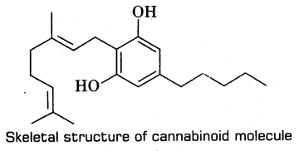
2. Cannabinoids:
These dilate the pupil, increasing urination and high sugar level.
These interact with cannabinoid receptors present in the brain.
Natural cannabinoids are obtained from inflorescence of Cannabis sativa.
There are 2 species of hemp plants where dried leaves and flower yield drugs
3. Coca- alkaloids/ cocaine:
It is obtained from the leaves and young branches of the plant Erythroxylum coca (coca plant).
Cocaine interferes with the transport of neurotransmitter dopamine.
It is usually taken by smoking.
It has a potential stimulating action on the CNS and produces a sense of Euphoria and increase energy but excessive use causes severe headache, convulsion, hallucinations and death due to cardiovascular or respiratory fail-ure.

Slide 35
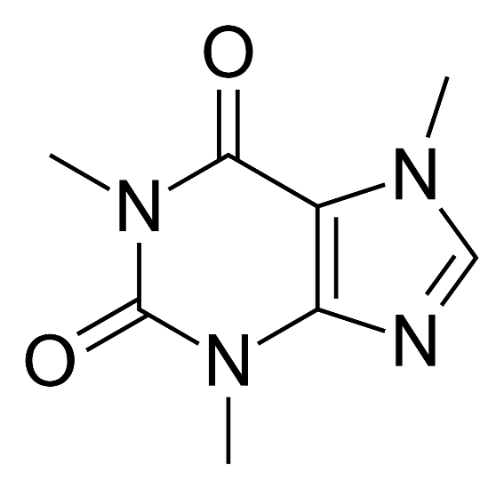
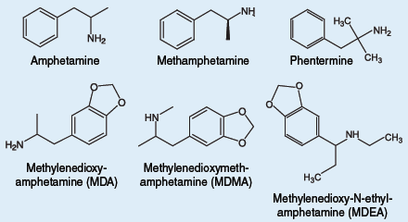
4. Caffeine
Obtained from the seed of the coffee plant, Coffea arabica, leaves of tea- plant (Camellia sinensis) and seeds of cocoa plant.
It is used as cardiac and nervous stimulants.
5. Amphetamines
These are synthetic drugs and act as a strong stimulant of CNS.

Slide 36
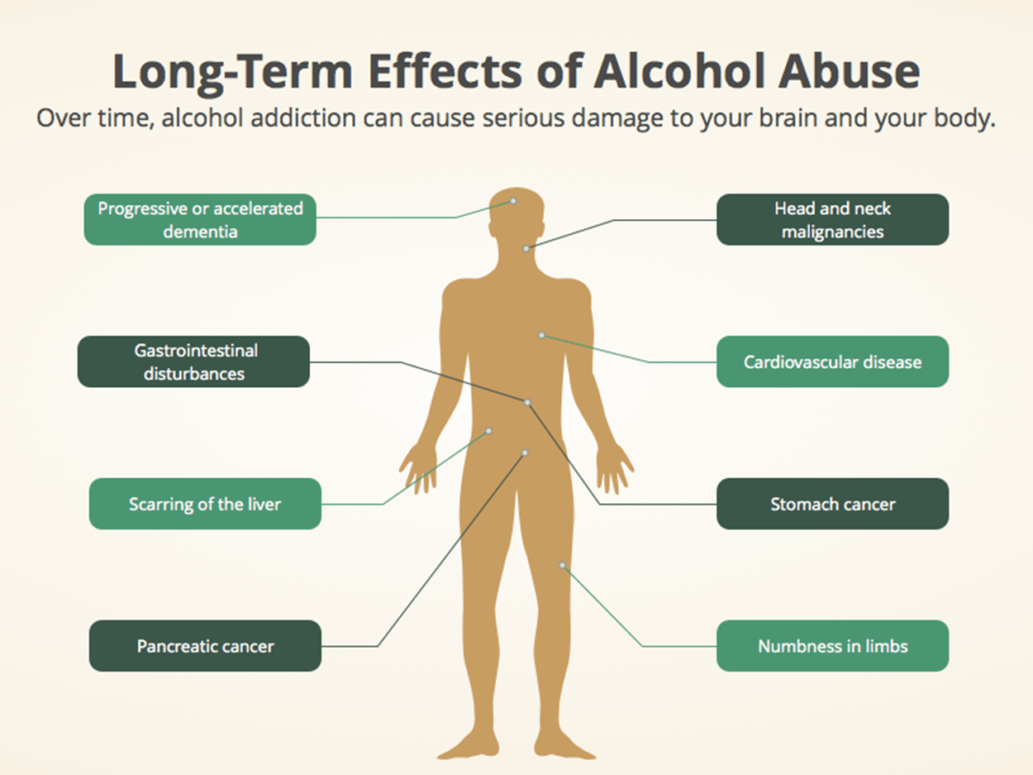

Slide 37
Effects of Drugs/ Alcohol abuse
Reckless behavior, vandalism and violence.
Excess dose can lead to coma and death.
Fluctuation in weight
Aggressive and rebellious behaviour
Change in sleeping and eating habits.
If drugs are taken intravenously it can lead to infections like AIDS and hepatitis.
Damage CNS and livers.

Slide 38
Prevention and Control
Avoid undue peer pressure
Education and counselling to face problems and stresses and to accept failures and disappointments as a part of life.
Seeking help from parents and peers could help to Vent their feeling of anxiety and guilt.
Addicts can be rehabilitated by seeking professional and medical help from the highly qualified psychologist and psychiatrist.

