Slide 1
CLASS – 9
SUBJECT – SCIENCE
CHAPTER – 15
CONCEPT – IMRPOVEMENT IN FOOD RESOURCES
PPT – 1

Slide 2
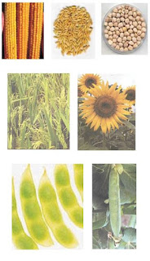
IMPROVEMENT IN FOOD RESOURCES
CHAPTER-15

Slide 3
INTRODUCTION
Food supplies proteins, carbohydrates, fats, vitamins and minerals, all of which we require for body development, growth and health.
Different crops require different climatic conditions, temperature and photoperiods for their growth and completion of their life cycle. Photoperiods are related to the duration of sunlight. Growth of plants and flowers are dependent on sunlight.

Slide 4
Successful crop production depends upon many factors such as:
Understanding how crops grow and develop.
Effect of various nutrients, climate, water on the growth of the plant.
Modification and management of each factor for increasing the yield of the crop.

Slide 5
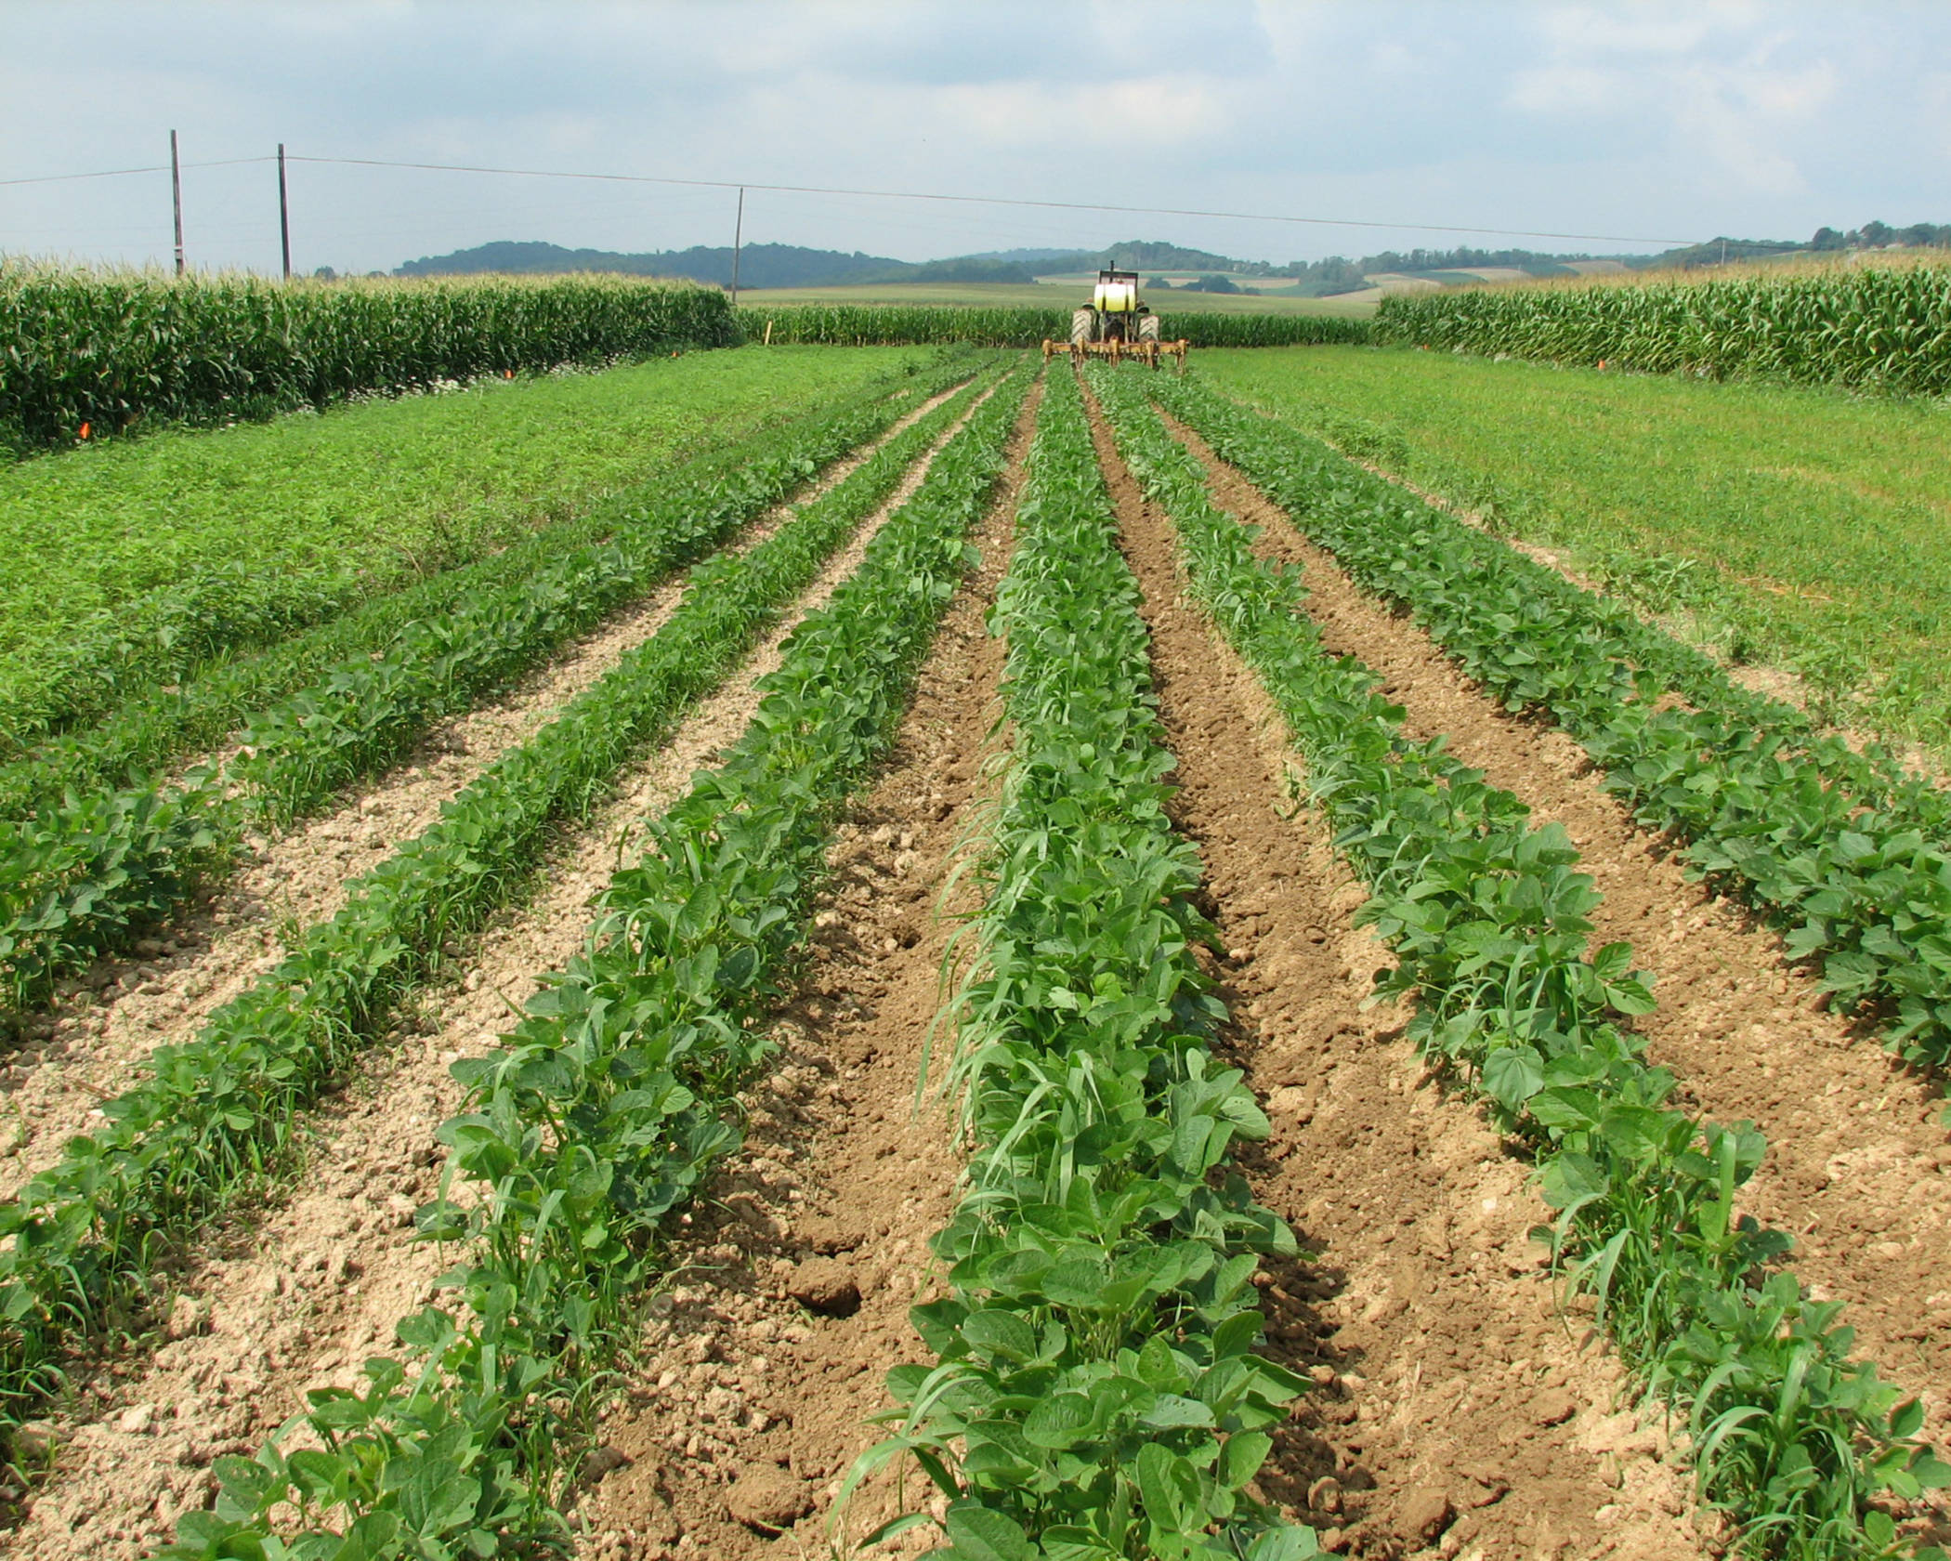
TYPES OF CROP
The crops which are grown in rainy season (the kharif season, from June to October) are called as kharif crops.
Example: Paddy, soyabean, pigeon pea, maize, cotton, green gram and black gram are kharif crops.
The crops which are grown in winter season (the rabi season, from November to April) are called rabi crops.
Example: Wheat grain, peas, mustard and linseed are rabi crops.

Slide 6
Crop variety improvement: It can be done either by hybridization or by introducing a gene.
Crop improvement by hybridization: Hybridization refers to crossing between genetically dissimilar plants. This crossing may be interparietal (between different varieties), interspecific (between two different species of the same genus) or intergeneric (between different genera).
Crop improvement by introducing a gene: This provides the desired characteristics and results in genetically modified crops.

Slide 7
Cultivation practices and crop yield are related to weather, soil quality and availability of water. Since weather conditions such as drought and flood situations are unpredictable, varieties that can be grown in diverse climatic conditions are useful.

Slide 8
The factors for which variety improvement is done are:
(i) Higher yield: To increase productivity of the crop per acre.
(ii) Improved quality: The quality of crop products vary from crop to crop. E.g., protein quality is important in pulses, oil quality in oilseeds, preserving quality in fruits and vegetables.
(iii) Biotic and abiotic resistance: Biotic factors are the diseases, insects and nematodes while abiotic factors are the drought, salinity, water logging, heat, cold and frost which affect the crop productivity. Varieties resistant to these factors (stresses) can be improved to increase crop production.
(iv) Change in maturity duration: Shorter maturity period of crop reduces the cost of crop production and makes the variety economical. Uniform maturity makes the harvesting process easy and reduces losses during harvesting.
(v) Wider adaptability: It allows the crops to be grown under different climatic conditions in different areas.
(vi) Desirable agronomic characteristics: It increases productivity, for example, tallness and profuse branching are desirable characters for fodder crops; while dwarfness is desired in cereals, so that less nutrients are consumed by these crops.

Slide 9
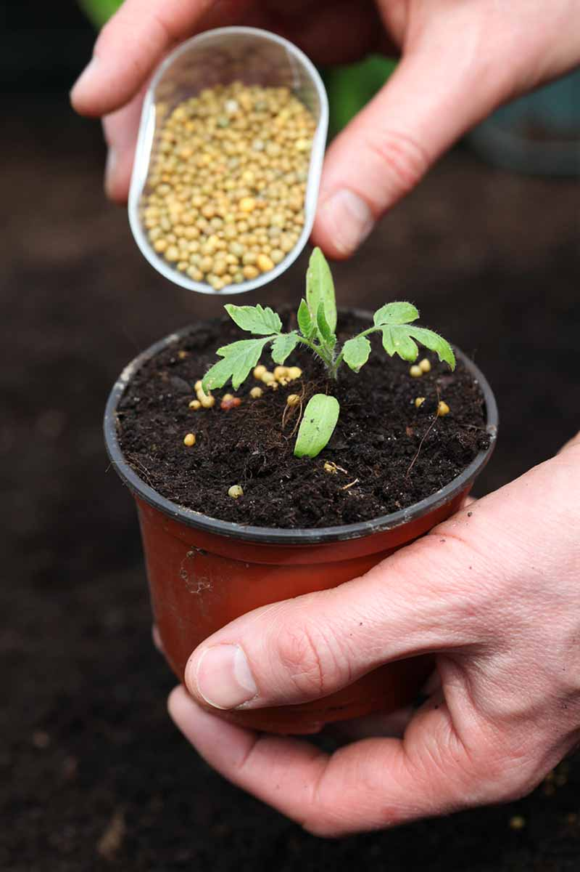
Plant nutrients: Nutrients are supplied to plants by air, water and soil. There are sixteen nutrients which are essential for plants. Air supplies carbon and oxygen; hydrogen comes from water and soil supplies the other thirteen nutrients to plants. Amongst these thirteen nutrients, six are required in large quantities and are therefore called macro-nutrients. The other seven nutrients are used by plants in small quantities and are therefore called micro-nutrients.

Slide 10
Nutrients supplied by air, water and soil
Source | Nutrients
Air | Carbon, Oxygen
Water | Hydrogen, Oxygen
Soil | (i) Macro-nutrients: Nitrogen, phosphorus, potassium, calcium and sulphur.
 | (ii) Micro-nutrients: Iron, manganese, boron, zinc, copper, molybdenum and chlorine.

Slide 11
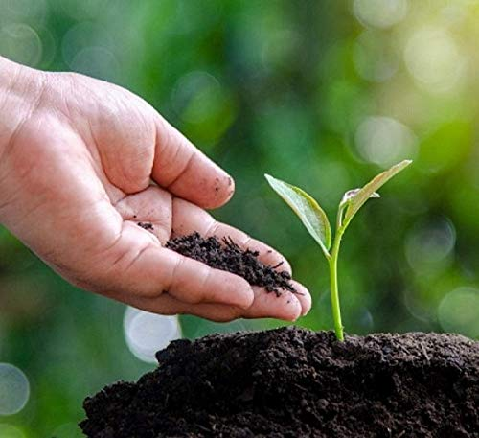
Manure:
Manure contains large quantities of organic matter and also supplies small quantities of nutrients to the soil. Manure is prepared by the decomposition of animal excreta and plant waste. Manure helps in enriching soil with nutrients and organic matter and increasing soil fertility. On the basis of the kind of biological waste used to make manure, it can be classified into three types:
Compost
Vermi-compost
Green manure.

Slide 12
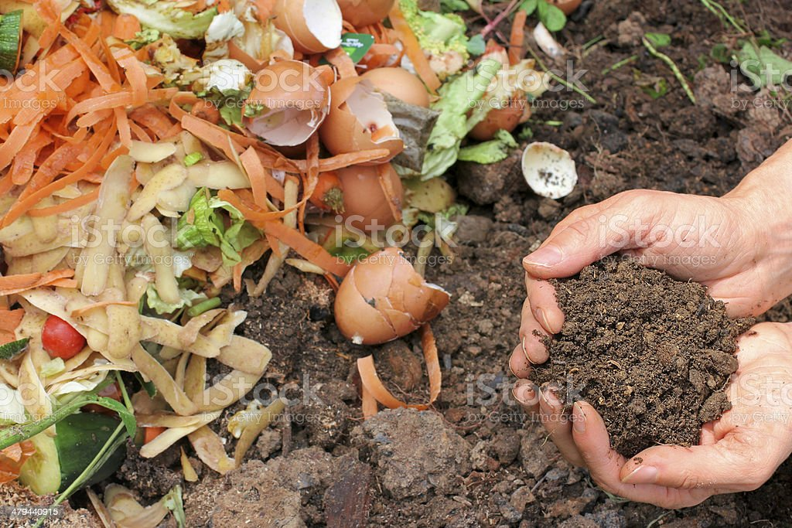
(i) Compost:
It can be farm waste material such as livestock excreta (cow dung etc.), vegetables waste, animal refuse, domestic waste, sewage waste, straw, eradicated weeds, etc. This material is decomposed in pits and this process of decomposition is also called composting. This compost is rich in organic matter and nutrients.

Slide 13
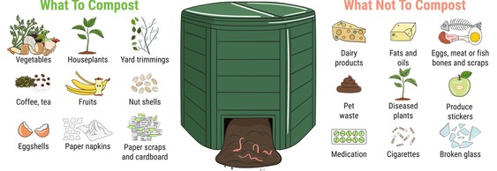

Slide 14
(ii) Vermi-compost:
The compost which is made by the decomposition of plant and animal refuse with the help of redworm is called vermi-compost.

Slide 15
(iii) Green manure:
Prior to the sowing of the crop seeds, some plants like sun hemp or guar are grown and then mulched by ploughing them into the soil. These green plants thus turn into green manure which helps in enriching the soil in nitrogen and phosphorus.

Slide 16
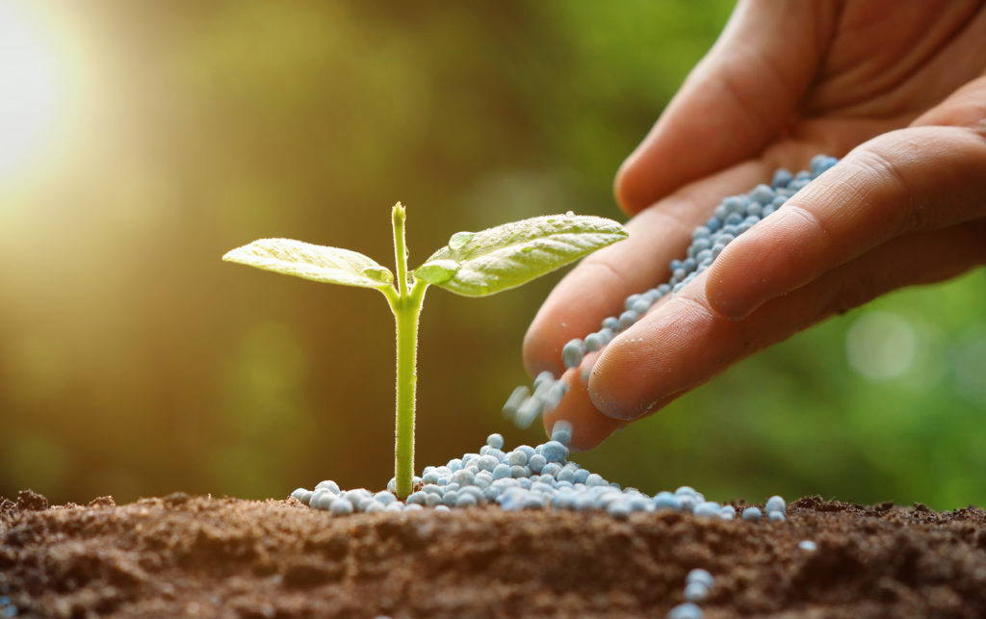
Fertilizers:
Fertilizers are commercially produced plant nutrients. Fertilizers supply nitrogen, phosphorus and potassium. They are used to ensure good vegetative growth (leaves, branches and flowers), giving rise to healthy plants. Fertilizers are an important factor in the higher yields of high-cost farming.

Slide 17
Organic farming:
It is a farming system with minimal or no use of chemicals as fertilizers, herbicides, pesticides, etc. and with a maximum input of organic manures, recycled farm-wastes (straw and livestock excreta), use of bio-agents such as culture of blue-green algae in preparation of biofertilizers, neem leaves or turmeric specifically in grain storage as bio-pesticides with healthy cropping systems [mixed cropping inter-cropping and crop rotation]. These cropping systems are beneficial in insect, pest and weed control besides providing nutrients.

Slide 18
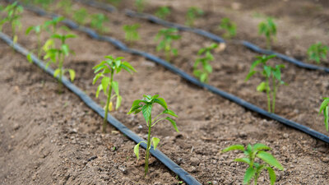
Irrigation:
Proper irrigation is very important for the success of crops. Ensuring that the crop gets water at the right stages during their growing season, can increase the expected yield of a crop. Different kinds of irrigation systems include wells, canals, rivers and tanks.
(i) Wells: These are of two types namely dug wells and tube wells. In a dug well, water is collected from water bearing strata. Tube wells can tap water from the deeper strata. From these wells, water is lifted by pumps for irrigation.

Slide 19
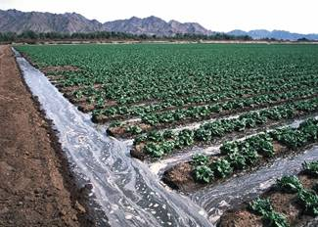
Irrigation:
(ii) River lift system: In areas where canal flow is insufficient or irregular due to inadequate reservoir release, the lift system is more rational. Water is directly drawn from the rivers for supplementing irrigation in areas close to rivers.
(iii) Tanks: These are small storage reservoirs, which intercept and store the run-off of smaller catchment areas.

Slide 20
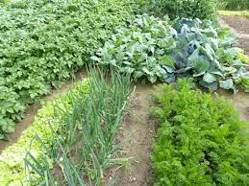
Cropping patterns:
It includes different ways of growing crops so as to get the maximum benefit. These different ways include the following:
(i) Mixed cropping: Mixed cropping is growing two or more crops simultaneously on the same piece of land, for example, wheat + gram, or wheat + mustard, or groundnut + sunflower. This reduces disease risk and gives some insurance against failure of one of the crops.

Slide 21
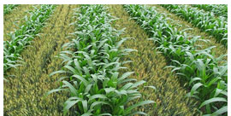
Cropping patterns:
(ii) Inter-cropping: It involves growing two or more crops simultaneously on the same field in definite proportion or pattern. A few rows of one crop alternate with a few rows of a second crop, for example, soyabean + maize, or finger millet (bajra) + cowpea (lobia). The crops are selected such that their nutrient requirements are different. This ensures maximum utilisation of the nutrients supplied, and also prevents pests and diseases from spreading to all the plants belonging to one crop in a field. This way, both crops can give better returns.

Slide 22
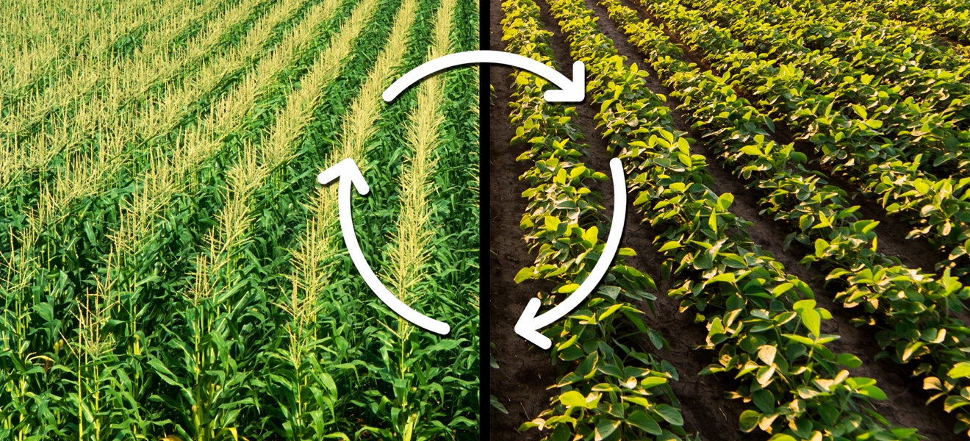
Cropping patterns:
(ii) Crop rotation: The growing of different crops on a piece of land in a preplanned succession is known as crop rotation. Depending upon the duration, crop rotation is done for different crop combinations. The availability of moisture and irrigation facilities decide the choice of the crop to be cultivated after one harvest. If crop rotation is done properly then two or three crops can be grown in a year with good harvest.

Slide 23
The food requirements of dairy animals are of two types:
(a) maintenance requirement which is the food required to support the animals to live a healthy life, and
(b) milk producing requirement, which is the type of food required during the lactation period.

Slide 24
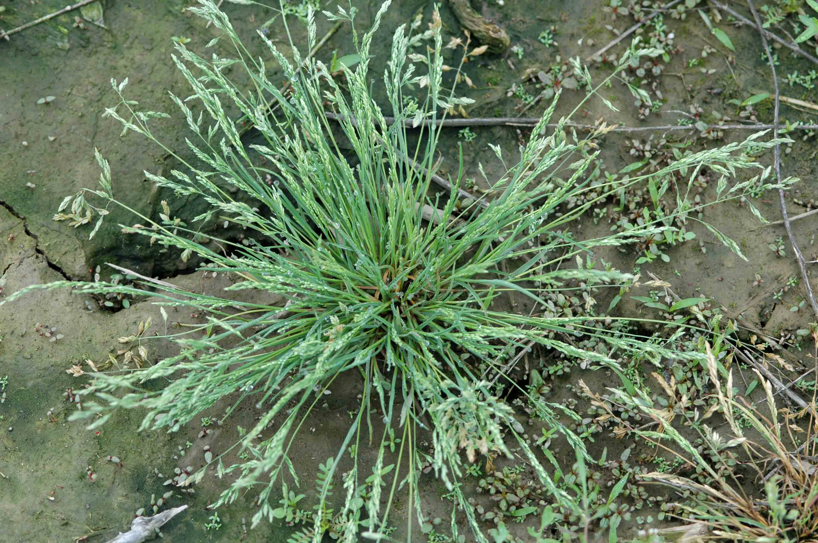
Weeds:
Weeds are unwanted plants in the cultivated field, for example, Xanthium (gokhroo), Parthenium (gazar ghas) and Cyperinus rotundus (motha). They compete for food, space and light. Weeds take up nutrients and reduce the growth of the crop. Therefore, removal of weeds from cultivated fields during the early stages of crop growth is essential for a good harvest.

Slide 25
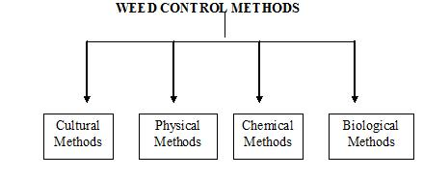
Methods of weed control:
The most effective method is the mechanical removal. Preventive methods such as proper seed bed preparation, finely sowing of crops, inter-cropping and crop rotation also help in weed control.

Slide 26
Insect pests:
Generally insect pests attack the plants in three ways:
They cut the root, stem and leaf,
they suck the cell sap from various parts of the plant, and
They bore into stem and fruits. They thus affect the health of the crop and reduce yields.

Slide 27
Preventive measures against pest include:
(i) The use of disease resistant varieties.
(ii) Growing two or more crops simultaneously on the same field.
(iii) Summer ploughing: In this method, fields are ploughed deep in summers to destroy both pests as well as weeds.

Slide 28
Animal husbandry
Animal husbandry is the scientific management of animal livestock. It includes various aspects such as feeding, breeding and disease control. Animal-based farming includes cattle, goat, sheep, poultry and fish farming.
Milk producing females are called milch animals (dairy animals), while the one used for farm labour are called draught animals.

Slide 29
Animal feed includes:
Roughage, which is largely, fibre and
Concentration which are low in fibre and contain relatively high levels of protein and other nutrients.

Slide 30
The improved poultry breeds are developed for the following desirable traits:
(i) Number and quality of chicks.
(ii) Dwarf broiler parent for commercial chick production.
(iii) Summer adaptation capacity.
(iv) Low maintenance requirements.
(v) Reduction in the size of the egg-laying bird with ability to utilise more fibrous cheaper diets formulated using agricultural by-products.

Slide 31
Production of poultry birds:
For good production of poultry birds, good management practices are important. These include maintenance of temperature and hygenic conditions in housing and poultry feed, as well as prevention and control of diseases and pests.
The housing, nutritional and environmental requirements of broilers are somewhere different from those of egg layers. The ration (daily food requirement) for broilers is protein rich with adequate fat. The level of vitamins A and K is kept high in the poultry feeds.

Slide 32
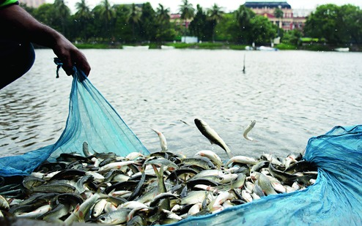
Fish Production:
There are two ways of obtaining fish. One is from natural resources, which is called capture fishing. The other way is by fish farming, which is called culture fishery.

Slide 33
Popular marine fish varieties include:
Pomphret, mackerel, tuna, sardines and Bombay duck. Marine fish of high economic value includes mullets, bhetki pearl spots, prawns, mussels and oysters.
As marine fish stocks get further depleted, the demand for more fish can only be met by culture fisheries, a practice called mariculture.

Slide 34
Fish resources are of two types:
(a) Fresh water resources such as canals, ponds, reservoirs and rivers.
(b) Brackish water resources (where sea water and fresh water mix together) such as estuaries and lagoons.

Slide 35
More extensive fish farming can be done in composite fish culture systems. Both local and imported fish species are used in such systems.

