Slide 1
CLASS – 9
SUBJECT – SCIENCE
CHAPTER – 6 (TISSUE)
CONCEPT – PLANT TISSUE
PPT – 1

Slide 2
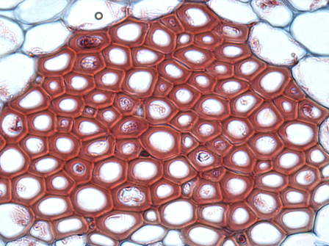

TISSUE

Slide 3
TISSUES
Tissues are a group of cells that combine together to perform a particular function.
In simple terms, tissue can be defined as a group of cells with similar shape and function are termed as tissues. They form a cellular organizational level, intermediate between the cells and organ system. Organs are then created by combining the functional groups of tissues.
The study of tissue is known as histology and study of disease-related to tissue is known as histopathology.

Slide 4
PLANT TISSUES
2. Geologic ages
The classification of plant tissues are mainly based on the two important criteria:
Based on the different part of plants.
Based on the different types of cells.
Plant Tissues are broadly categorized into three tissue systems. This classification is on the basis of parts of the plants they are present.
Epidermis Tissues – cells formed from the outermost surface of the leaves.
Vascular Tissues – involved in transporting fluid and nutrients internally.
Ground Tissue – involved in producing nutrients by photosynthesis and preserve nutrients.

Slide 5
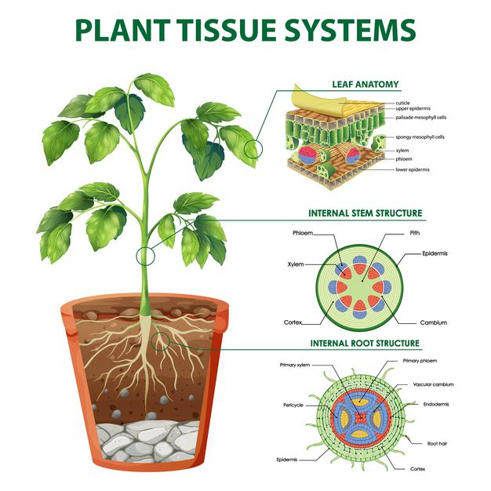
PLANT TISSUES
2. Geologic ages
Plant tissue is divided into two types. This classification is on the basis of the types of cells, they comprise.
Meristematic tissues.
Permanent tissues.

Slide 6
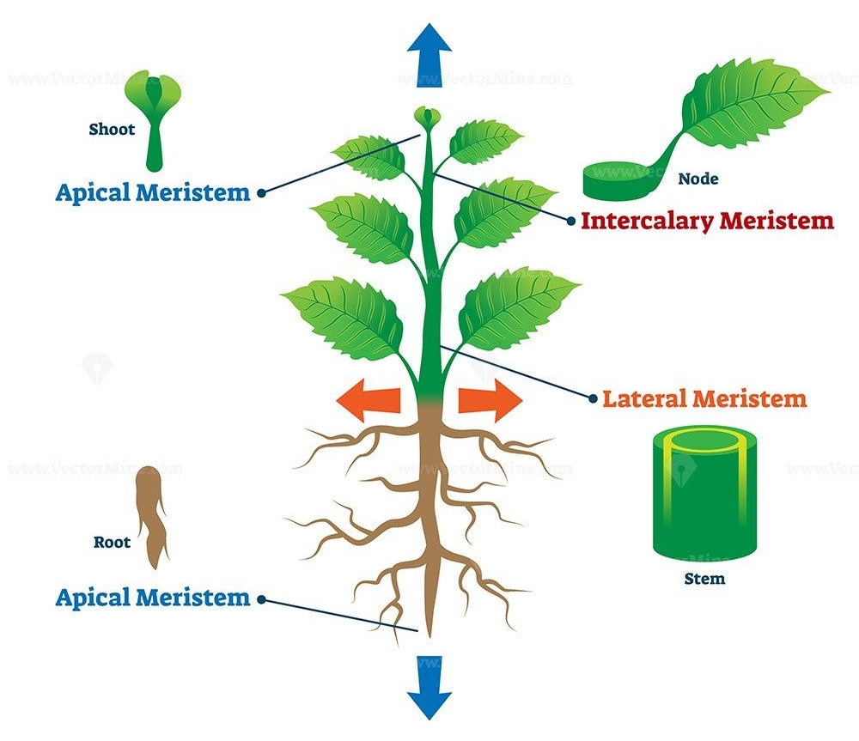
MERISTEMATIC TISSUES
2. Geologic ages
They are the group of young cells, which consists of continually dividing cells and helps in the increase of length and width of the plant.
There are different types of meristematic tissues, which are classified on the basis of positions, functions, plane of divisions, origin and development.
The three main types of meristematic tissues depending on the occurrence of the meristematic tissue on the plant body are:
Apical Meristem.
Lateral Meristem.
Intercalary Meristem.

Slide 7
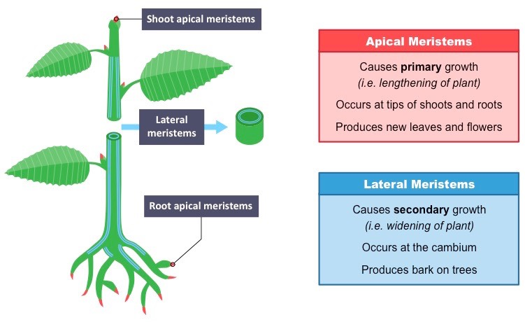
MERISTEMATIC TISSUES
2. Geologic ages
Apical meristem
Apical meristem are present on the apex of the plant shoot and root. They are rapidly growing tissues and aid in increasing the height of the plant.

Slide 8
MERISTEMATIC TISSUES
2. Geologic ages
Lateral meristem
Lateral meristem are present on the lateral walls of the stem. They help in the horizontal growth of the plant and increasing the stem girth.

Slide 9
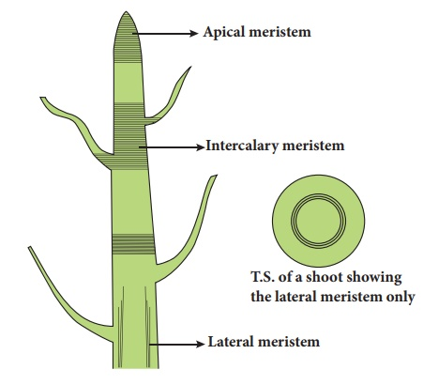
MERISTEMATIC TISSUES
2. Geologic ages
Intercalary meristem
Intercalary meristem can be found between the nodes of the stem and the base of the leaf. They help in branching.

Slide 10
MERISTEMATIC TISSUES
2. Geologic ages
Functions of Meristematic Tissue
It is responsible for the growth of the new organs.
Involved in the movement of water and nutrition within the plants.
These tissues are responsible for both primary and secondary growth of the plant.
It is the outermost tissue, functions by providing protection from mechanical injury.
It gives rise to epidermis layer, cortex, endodermis, ground tissue and vascular tissue.

Slide 11
PERMANENT TISSUES
2. Geologic ages
A group of cells which are similar in origin, structure and in function. They are involved in complete growth and differentiation during the ineffective of meristematic activity. There are three types of permanent tissues:
Simple Permanent Tissues.
Complex Permanent Tissues.
Special or Secretory Tissues.

Slide 12
PERMANENT TISSUES
2. Geologic ages
Simple permanent tissues
These are tissues that are made up of only one type of cells. They usually have structural role.
Sclerenchyma
Collenchyma
Parenchyma

Slide 13
PERMANENT TISSUES
2. Geologic ages
Parenchyma
Parenchyma tissues are made up of loosely packed cells with thin cell walls and large intercellular spaces. They are live cells and help in support and storage. Two types; Chlorenchyma and Arenchyma.
Collenchyma
Collenchyma tissues are made up of live cells which have irregularly thickened corners and thus, have decreased intercellular spaces. They help in bending of various parts of the plant without breaking.
Sclerenchyma
Sclerenchyma tissues make up the hard and stiff parts of the plant. They are made up of dead, long and narrow cells. They almost have no intercellular space as the walls are thickened due to the presence of lignin.

Slide 14
PERMANENT TISSUES
2. Geologic ages
XYLEM
PHLOEM
Complex permanent tissues
Complex permanent tissues are made by combination of different types of cells. These cells work together to perform a specific task.

Slide 15
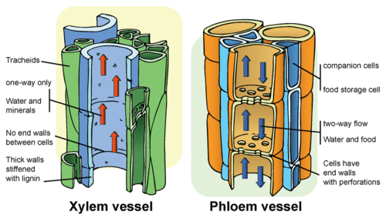
PERMANENT TISSUES
2. Geologic ages
Phloem
Phloem is made up of the following components – sieve tubes, companion cells, phloem parenchyma and phloem fibres. Phloem conducts food in both directions. Among all the components, phloem fibres are the only dead cells.

Slide 16
PERMANENT TISSUES
2. Geologic ages
Xylem
Xylem is made up of the following components. The vessels and tracheid's – help in conduction of water and minerals from the soil. Xylem parenchyma helps in food storage and the xylem fibres provide mechanical support.

Slide 17
PERMANENT TISSUES
2. Geologic ages
Functions of Permanent Tissues
In aquatic plants, these tissues help in floating.
Stores food in the form of starch, proteins, oils and fats.
They provide hardness to fruits such as nuts, coconut, almond etc.
These tissues contain chloroplast which helps in carrying out photosynthesis.
Permanent Tissues are also involved in the Secretion, Transportation, and provides mechanical support to the plants.

